Slide 1
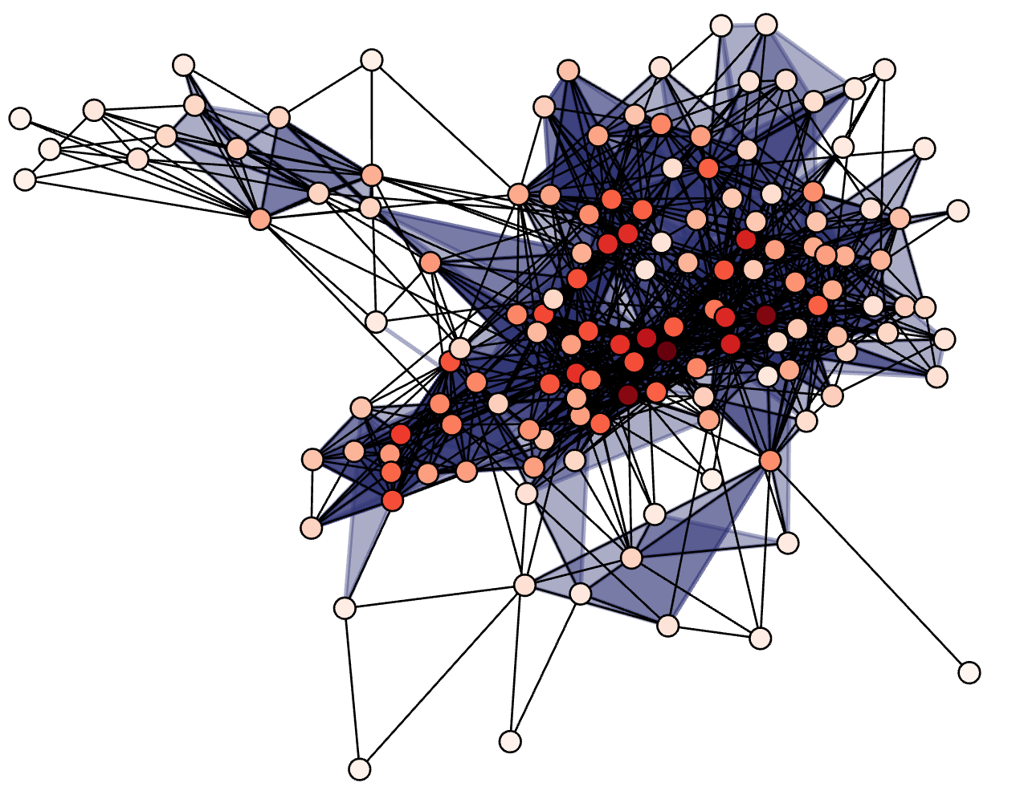


A Practical Guide to Modeling with Higher-order Networks
Nicholas W. Landry
University of Virginia

Slide 2
What is a higher-order network?

Slide 3

A complex system is…
“a system composed of many components which may interact with each other”
(Wikipedia)
Photo by Ryoji Iwata on Unsplash

Slide 4
Pairwise networks…
assume that only two entities interact at once
A pairwise network is:
a set of entities (nodes)
the collection of pairwise interactions between them (edges).
Photo by Ryoji Iwata on Unsplash

Slide 5
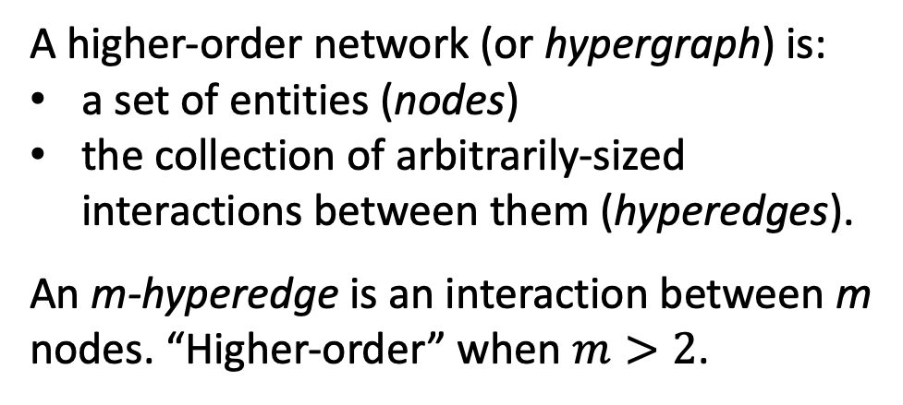
Higher-order networks…
assume that any number of entities may interact at once
A higher-order network (or hypergraph) is:
a set of entities (nodes)
the collection of arbitrarily-sized interactions between them (hyperedges).
An m-hyperedge is an interaction between m nodes. “Higher-order” when $m>2$.
Photo by Ryoji Iwata on Unsplash

Slide 6
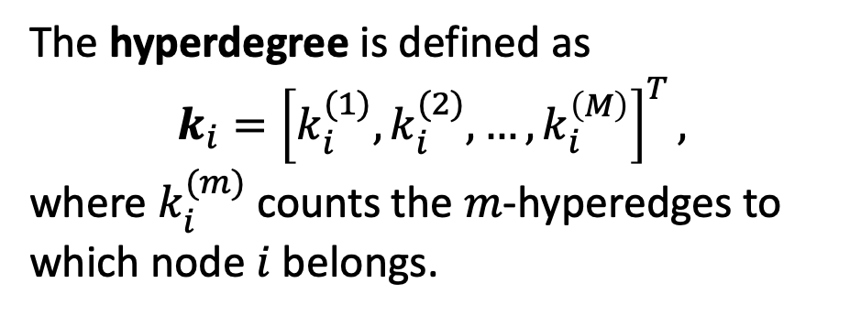
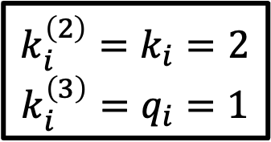
Terminology
$$k_{i}^{\left(2\right)}=k_{i}=2$$
$$k_{i}^{\left(3\right)}=q_{i}=1$$
2-hyperedge (link)
The hyperdegree is defined as
$$k_{i}={\left[k_{i}^{(1)},k_{i}^{(2)},…,k_{i}^{\left(M\right)}\right]}^{T},$$
where $k_{i}^{(m)}$ counts the $m$-hyperedges to which node $i$ belongs.
3-hyperedge (triangle)

Slide 7
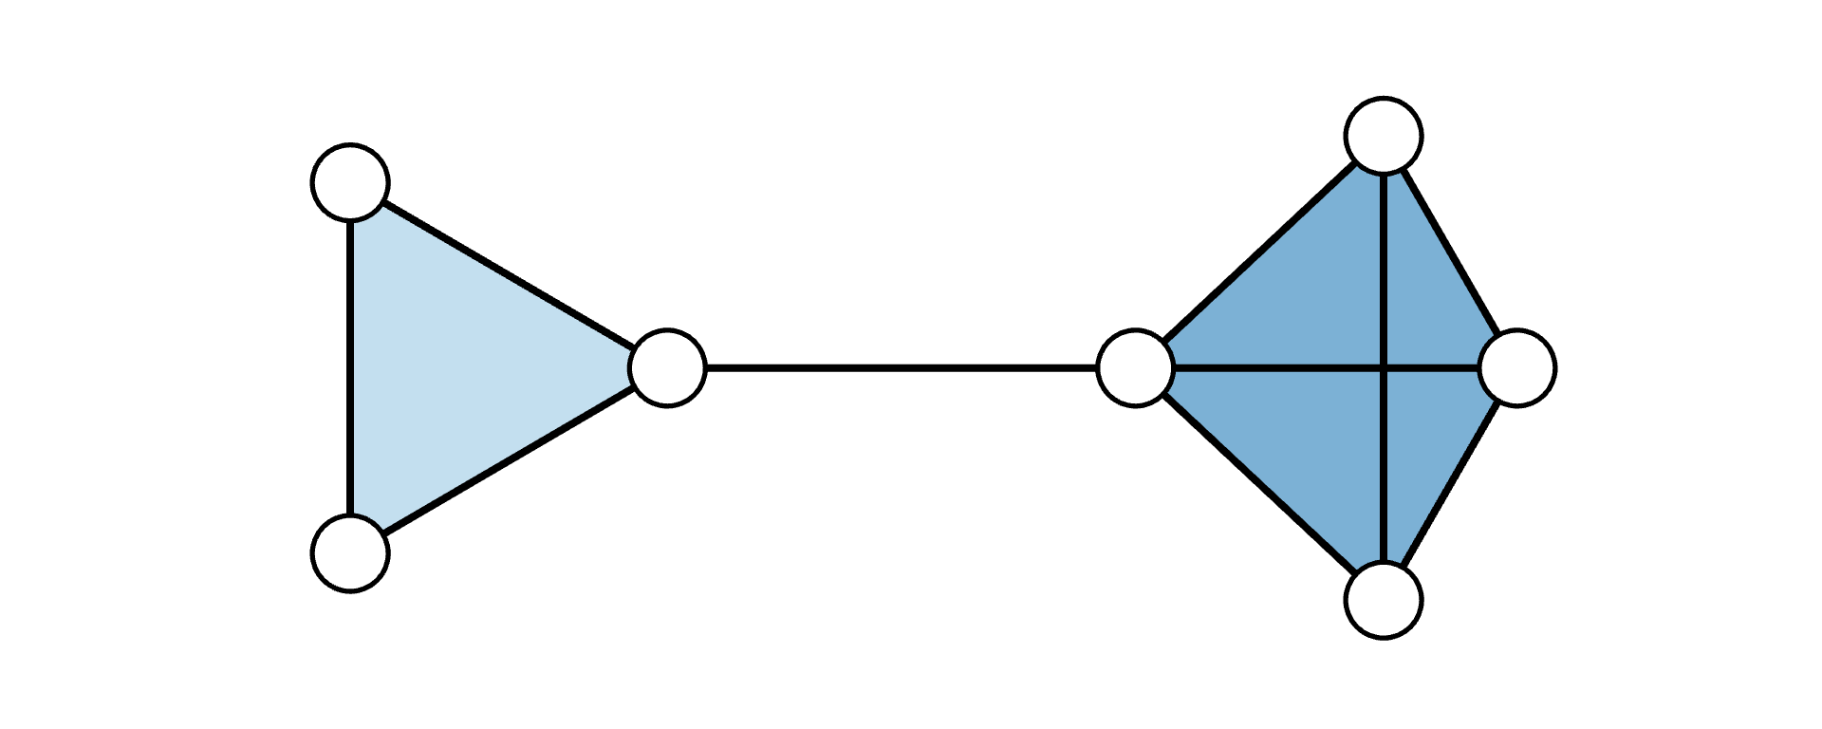
Simplicial complexes
A simplicial complex is a hypergraph with the added constraint of downward closure: that if an interaction exists, every sub-interaction (subface) also exists.
Ex.
C ={{1, 2, 3}, {1, 2}, {1, 3}, {2, 3}, {1}, {2}, {3}} describes a simplicial complex
E ={{1, 2, 3}, {1, 2}, {1, 3}} does not

Slide 8
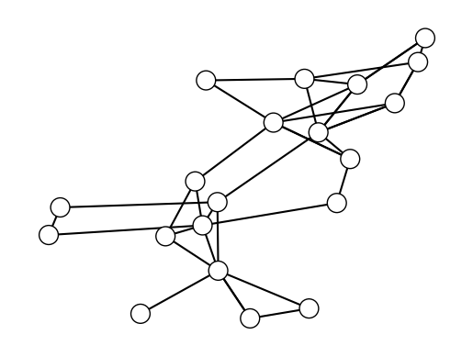
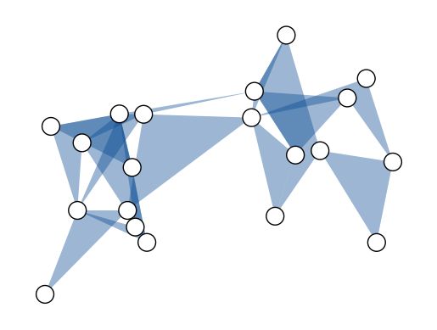
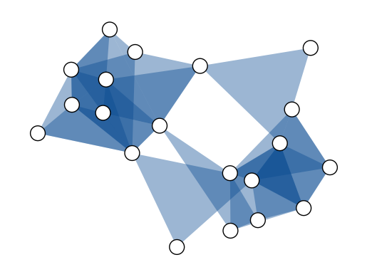
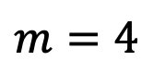
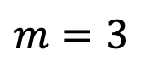
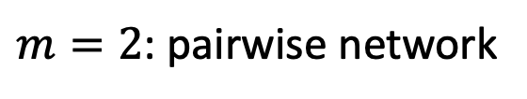
Uniform hypergraphs
A hypergraph with only size-$m$ hyperedges is called an $m$-uniform hypergraph
$m=2$: pairwise network
$$m=3$$
$$m=4$$

Slide 9
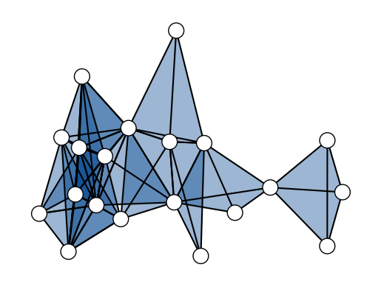
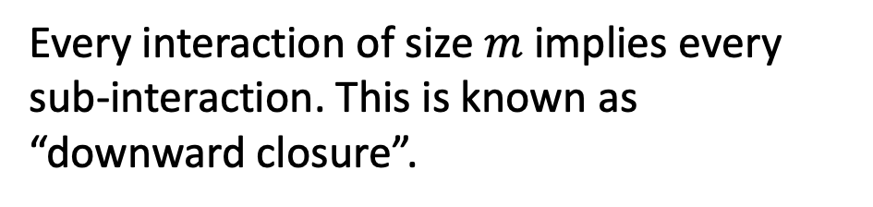
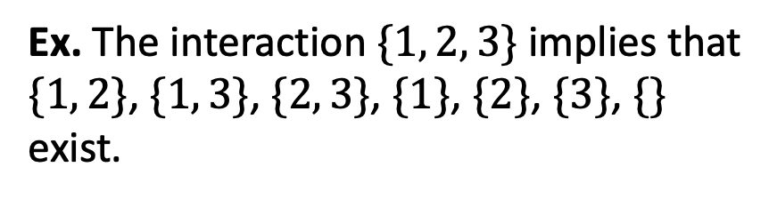
Simplicial complexes
Every interaction of size $m$ implies every sub-interaction. This is known as “downward closure”.
Ex. The interaction $\{1, 2, 3\}$ implies that
$\{1, 2\}$, $\{1, 3\}$, $\{2, 3\}$, $\{1\}$, $\{2\}$, $\{3\}$, $\{\}$
exist.

Slide 10
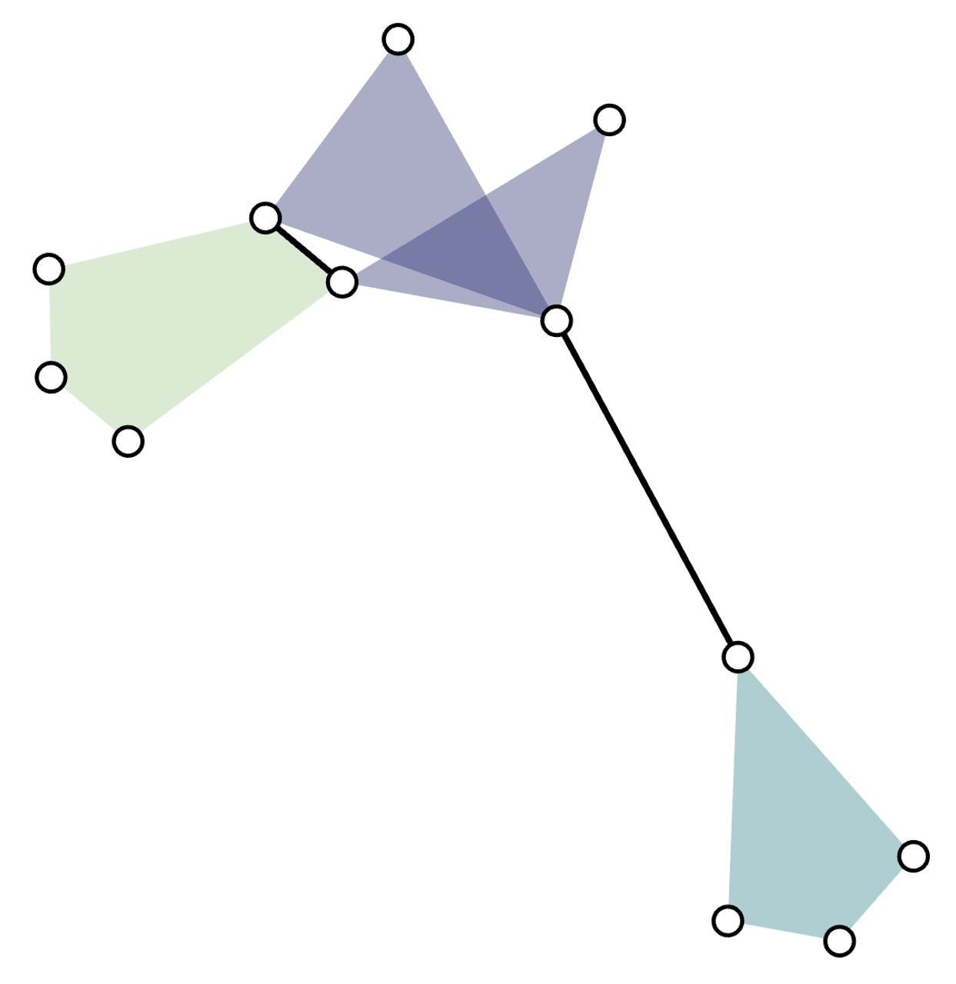
Undirected hypergraphs
Each hyperedge
is a set, e.g., {1, 2, 3}
is a multiset for loopy hyperedges, e.g., {1, 1, 3}
The collection of hyperedges
is a set for simple hypergraphs, e.g., {{1, 2, 3}, {3, 4}}
a multiset for hypergraphs with multiedges, e.g., [{1, 2, 3}, {1, 2, 3}]

Slide 11
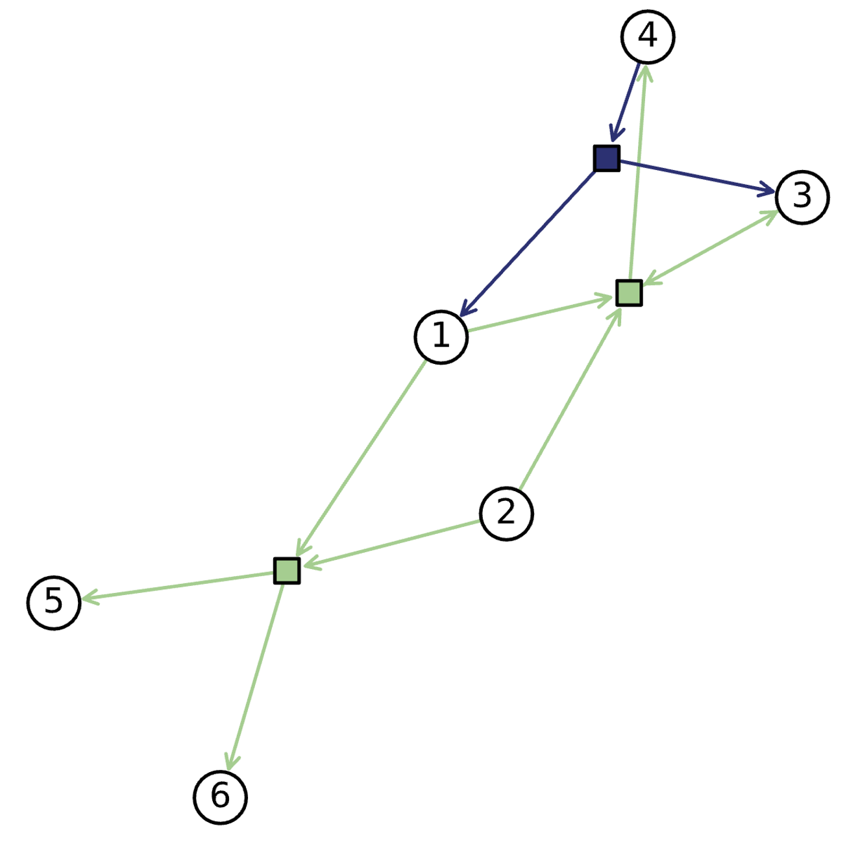
Directed hypergraphs
Each directed hyperedge represents incoming and outgoing interactions (think: chemical reactions, emails, etc.)
is an ordered pair: the tail and head.
The tail is the set of inputs, e.g., {1, 2, 3}
The head is the set of outputs, e.g., {3, 4, 5}
The head and tail can overlap.

Slide 12
Bipartite network
Type 1 nodes
Type 2 nodes
A bipartite network is a network with
nodes of two different types
edges which connect nodes of different types (nodes of the same type cannot be connected)

Slide 13
When should we use higher-order networks to model?

Slide 14
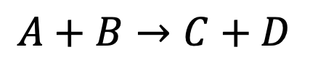

Intrinsically higher-order systems
Paper 1
C
Paper 2
≠
C
Co-authorship networks
Chemical reactions
A
A
Paper 3
Paper 1
B
B
Reaction 1
A
C
A
C
$$≠$$
D
B
D
B
$$A+B→C+D$$

Slide 15
Activity: what are examples of intrinsically higher-order systems?

Slide 16
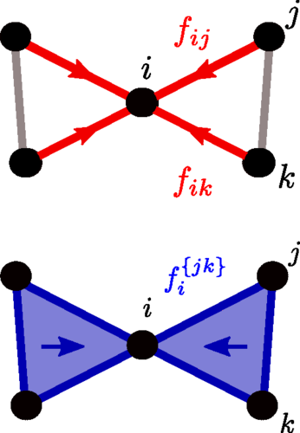
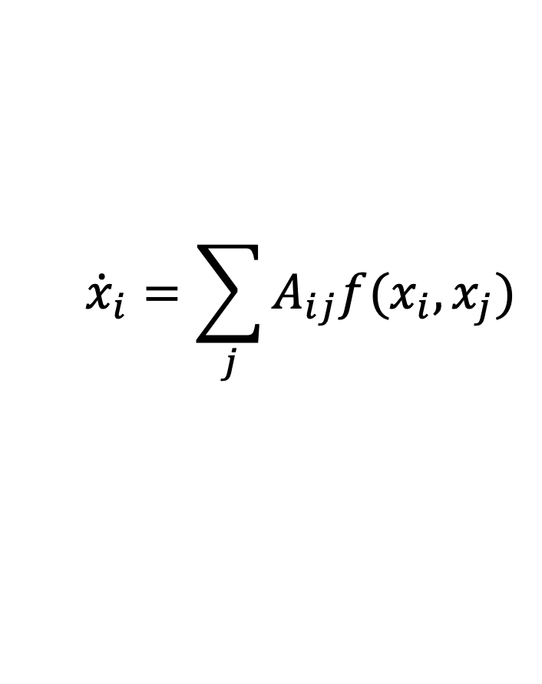
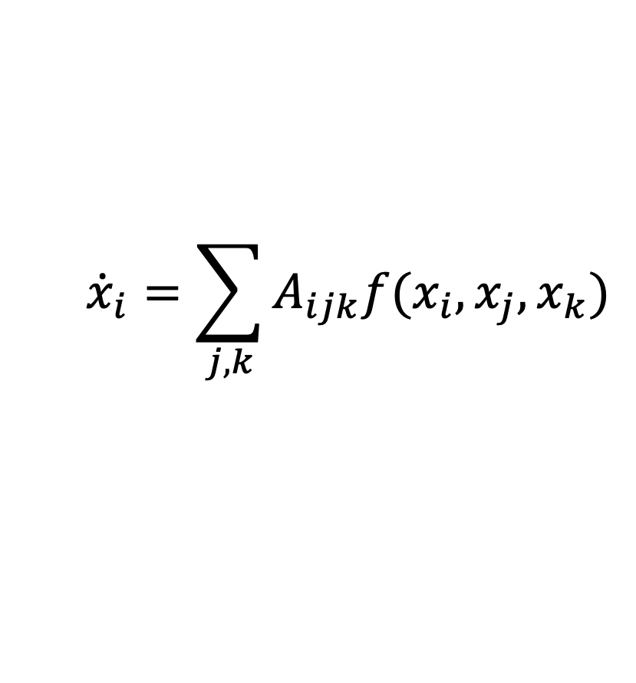
Nonlinear higher-order dynamics cannot be projected to pairwise network processes
?
=
$${\dot{x}}_{i}=\sum_{j}{A_{ij}f(x_{i},x_{j})}$$
$${\dot{x}}_{i}=\sum_{j,k}{A_{ijk}f(x_{i},x_{j},x_{k})}$$
Leonie Neuhäuser, Andrew Mellor, and Renaud Lambiotte, “Multibody interactions and nonlinear consensus dynamics on networked systems” Phys. Rev. E 101, 032310

Slide 17
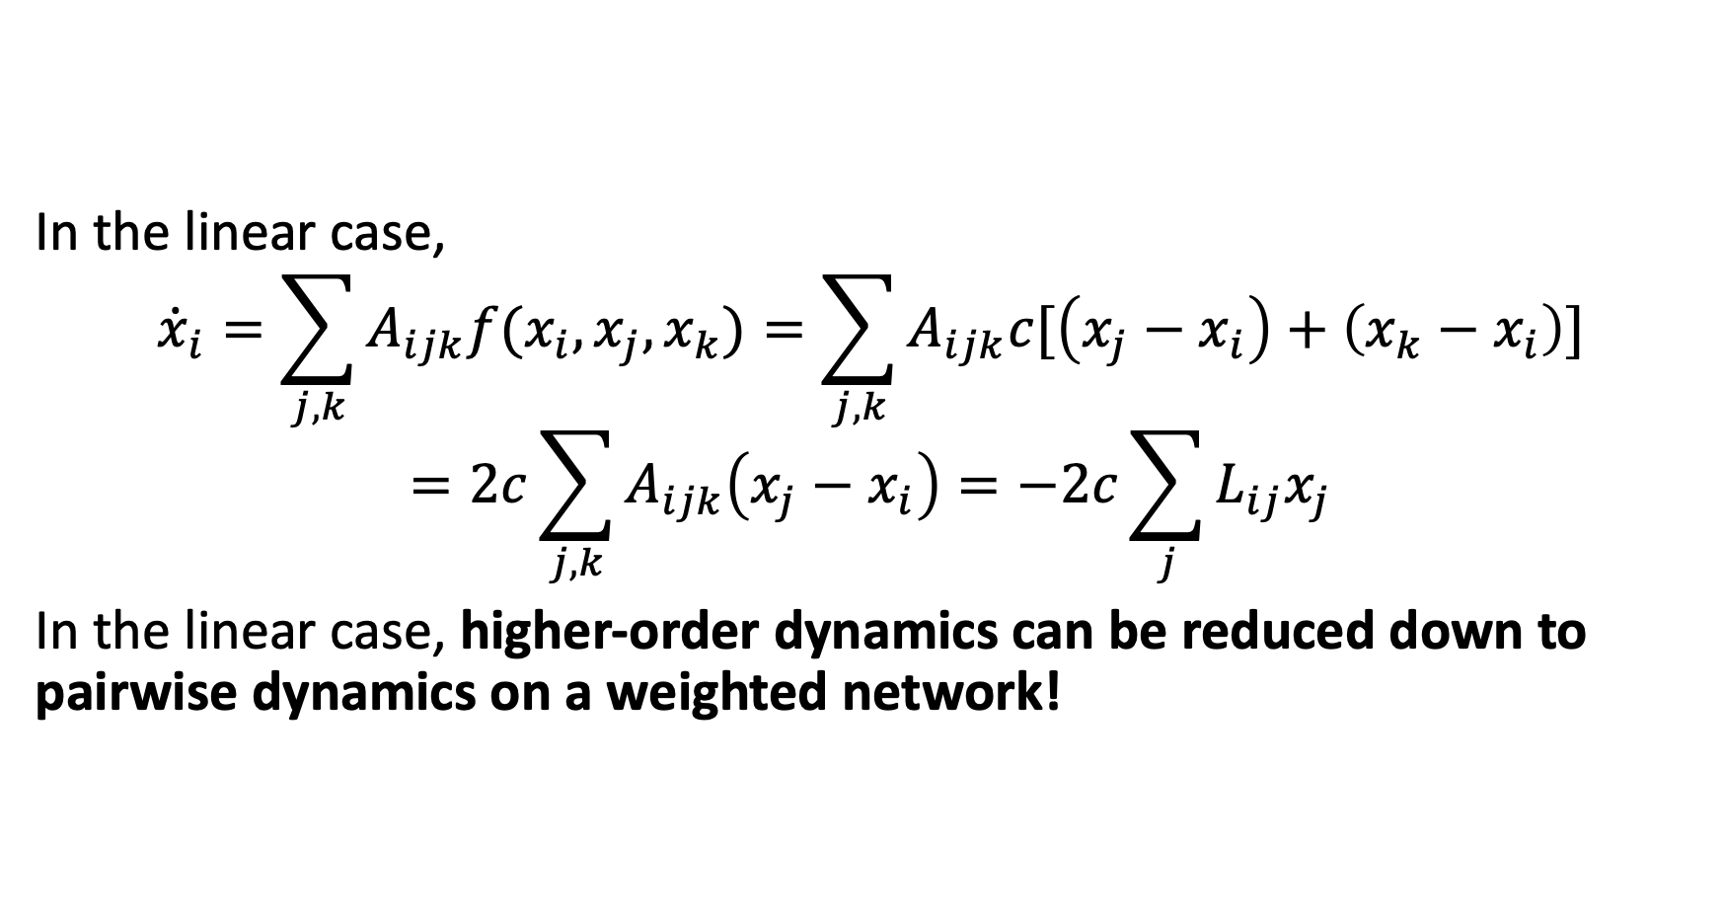
Nonlinear higher-order dynamics cannot be projected to pairwise network processes
In the linear case,
$${\dot{x}}_{i}=\sum_{j,k}{A_{ijk}f(x_{i},x_{j},x_{k})}=\sum_{j,k}{A_{ijk}c[\left(x_{j}−x_{i}\right)+\left(x_{k}−x_{i}\right)]}$$
$$=2c\sum_{j,k}{A_{ijk}\left(x_{j}−x_{i}\right)}=−2c\sum_{j}{L_{ij}x_{j}}$$
In the linear case, higher-order dynamics can be reduced down to pairwise dynamics on a weighted network!

Slide 18
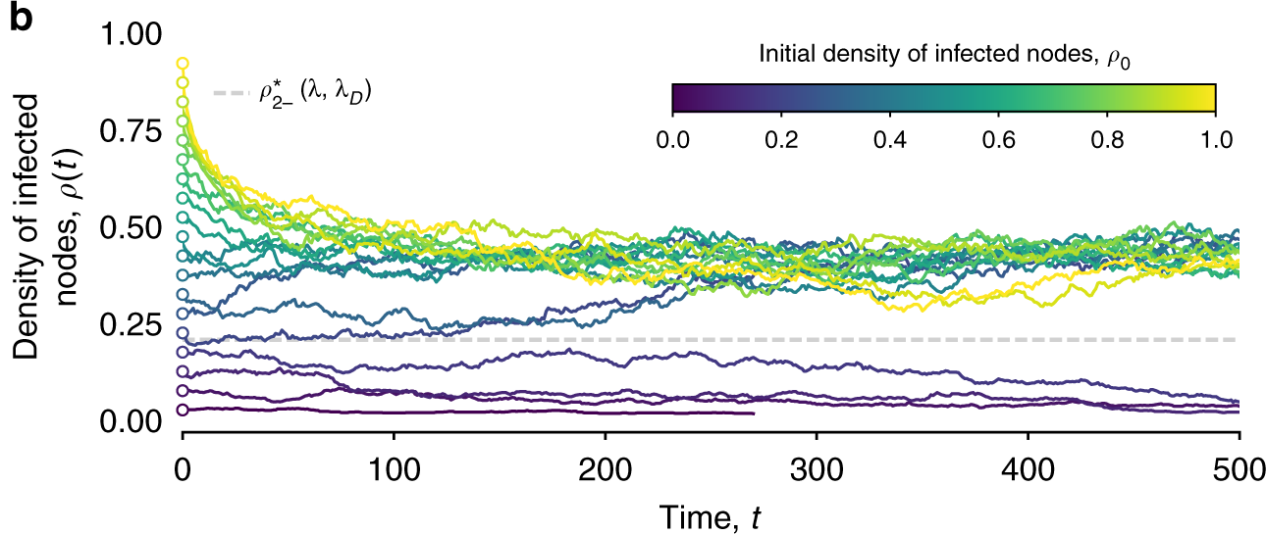
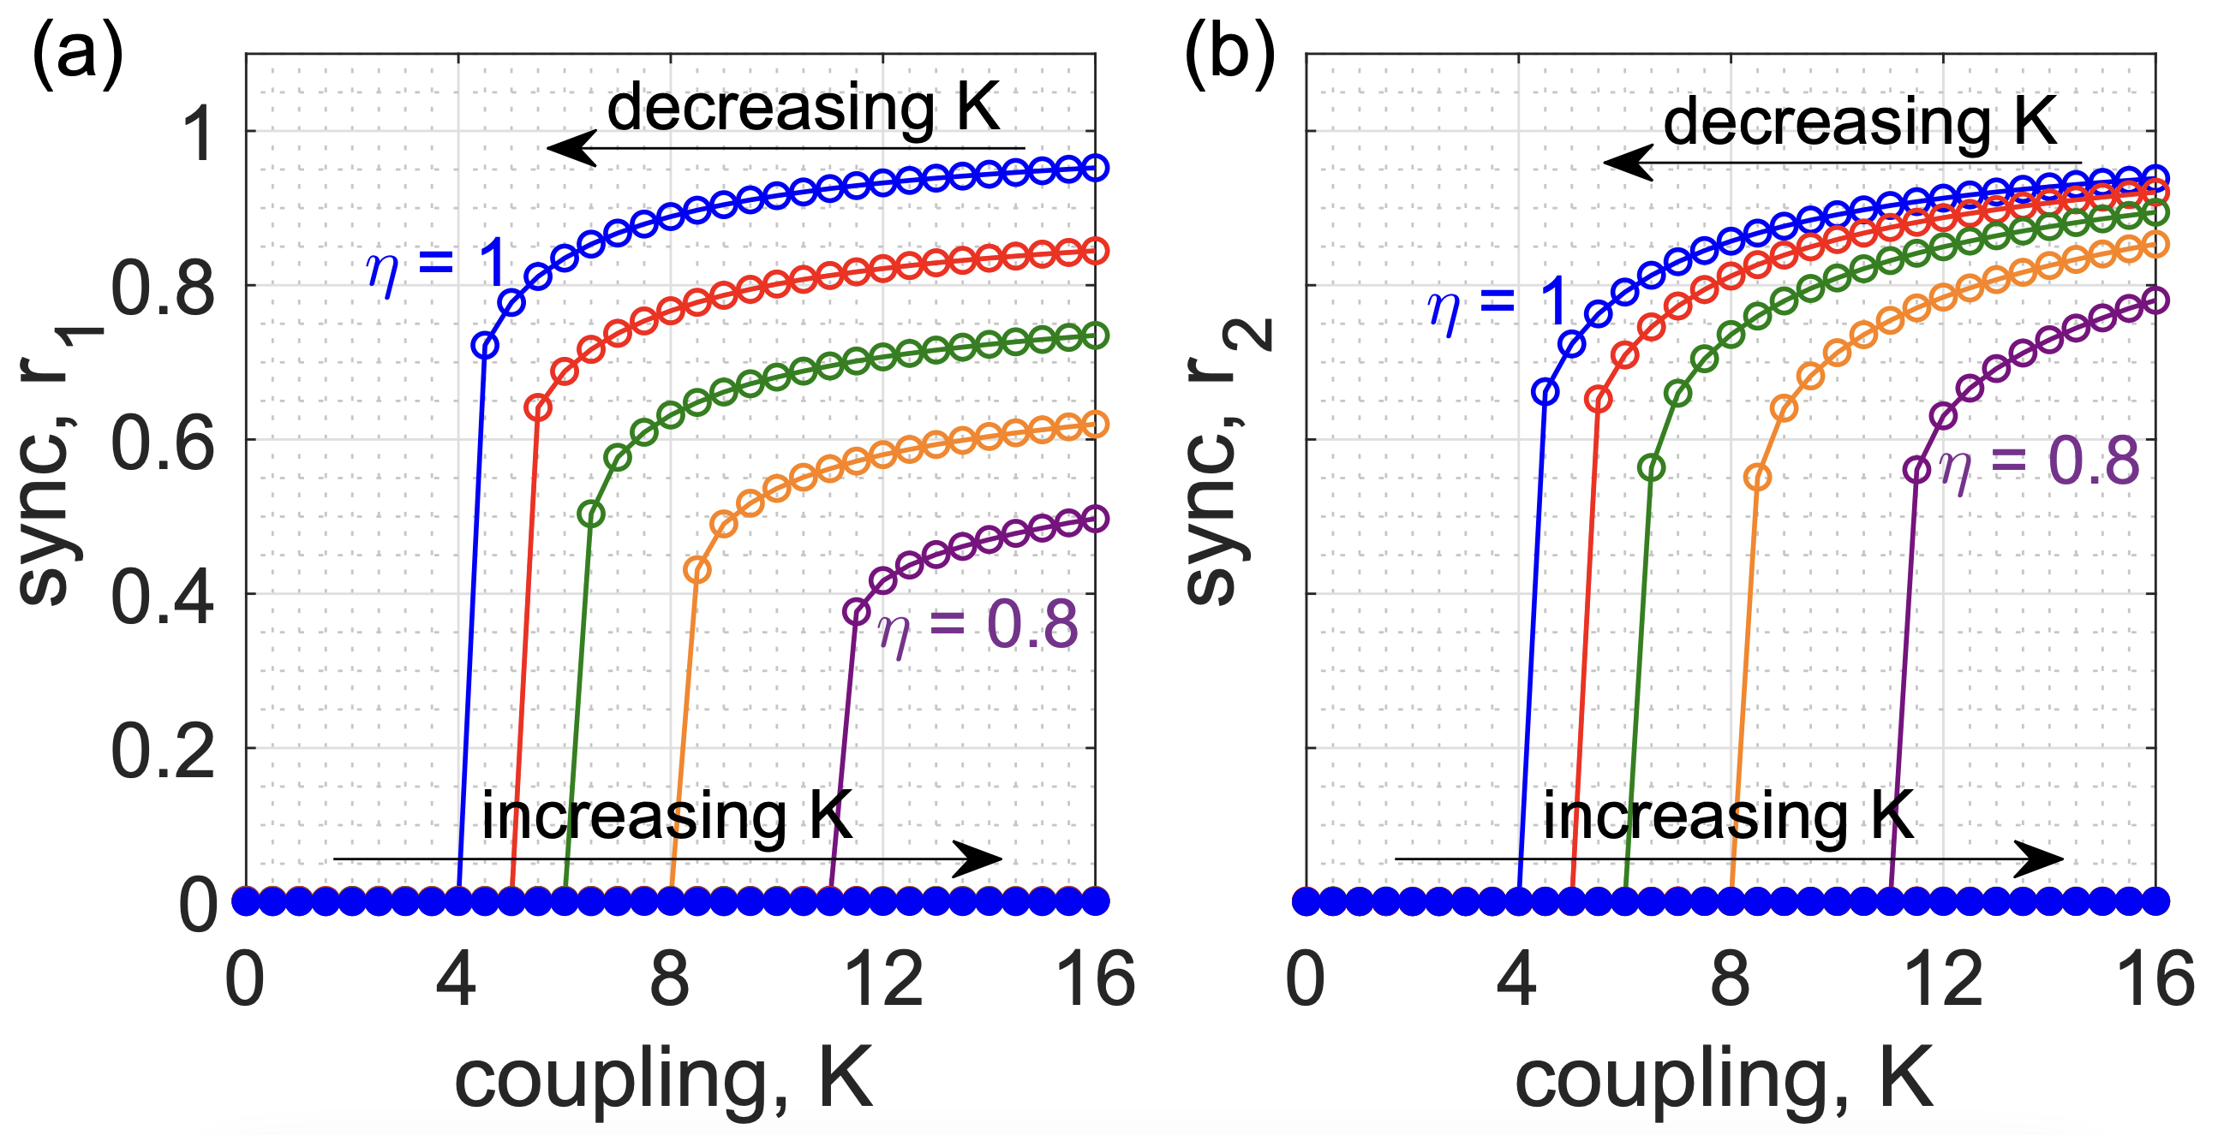
Examples of nonlinear higher-order dynamics
Hypergraph SIS model
Hypergraph Kuramoto model
Critical mass
Iacopini et al. Nature Communications (2019)
P. S. Skardal and A. Arenas Physical Review Letters (2019)

Slide 19
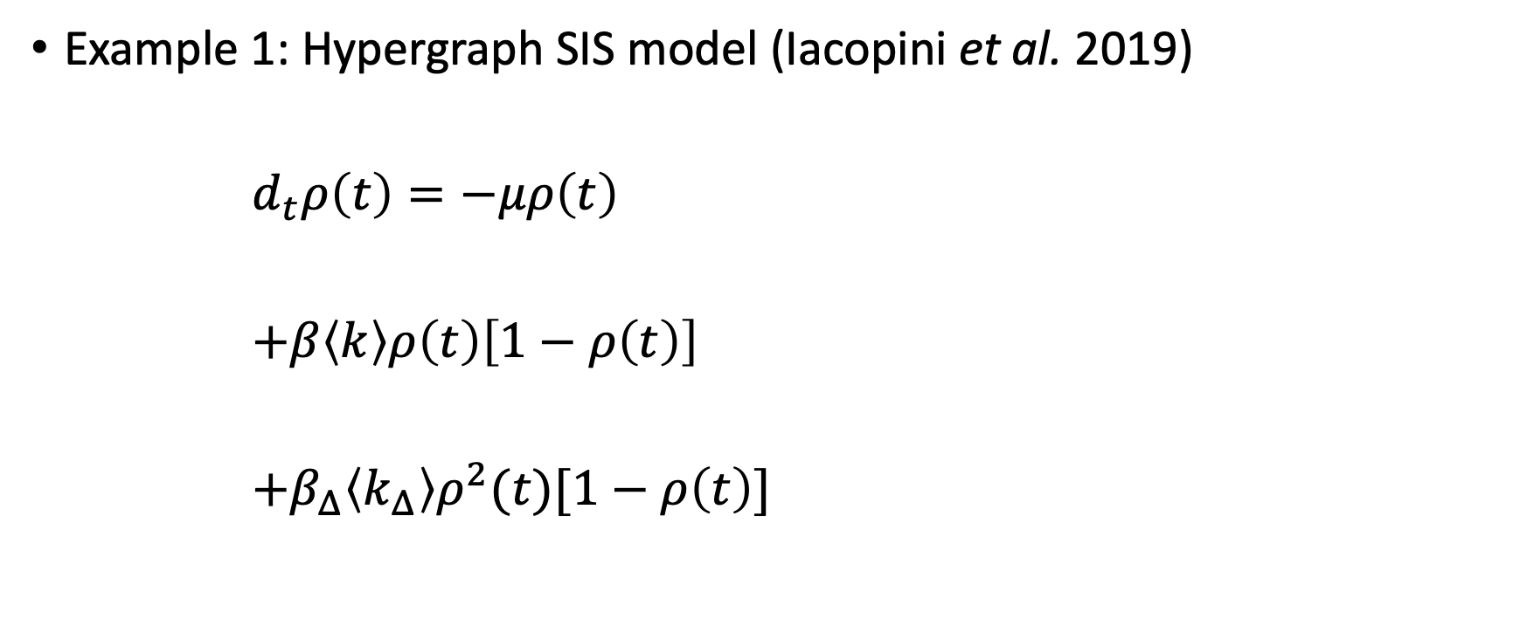

Examples cont.
Example 1: Hypergraph SIS model (Iacopini et al. 2019)
$d_{t}ρ\left(t\right)=−μρ\left(t\right)$
$+β\left\langle k\right\rangle ρ\left(t\right)\left[1−ρ\left(t\right)\right]$
$+β_{Δ}\left\langle k_{Δ}\right\rangle ρ^{2}(t)[1−ρ\left(t\right)]$
Healing
where $ρ(t)$ is the fraction of infected nodes
Pairwise Infection
Triangle Infection

Slide 20
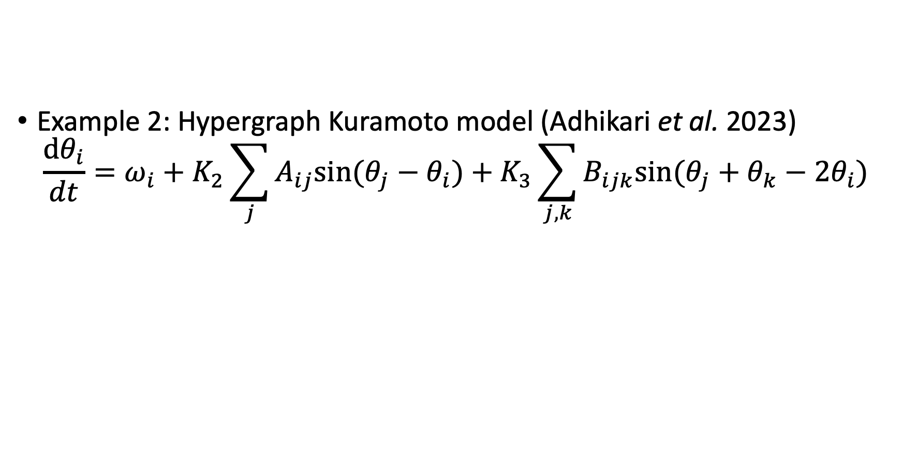
Examples cont.
Example 2: Hypergraph Kuramoto model (Adhikari et al. 2023)
$$\frac{dθ_{i}}{dt}=ω_{i}+K_{2}\sum_{j}{A_{ij}sin⁡(θ_{j}−θ_{i})}+K_{3}\sum_{j,k}{B_{ijk}sin⁡(θ_{j}+θ_{k}−{2θ}_{i})}$$
Nat. freq.
Pairwise synchronization
Three-way synchronization

Slide 21
How can we represent higher-order networks?

Slide 22
Representations of hypergraphs
Exact
Bipartite data structures
Bipartite edge list
Incidence matrix
Adjacency list
Other
Hyperedge list
Sets of tensors
Lossy
Adjacency matrix
Line graph

Slide 23
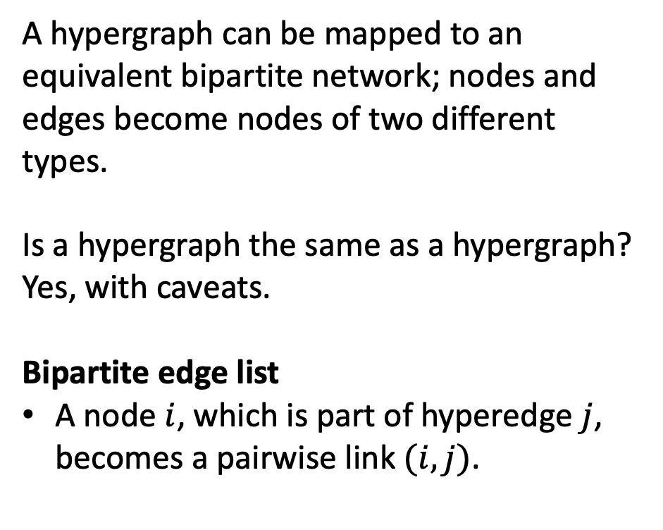
Bipartite network
A hypergraph can be mapped to an equivalent bipartite network; nodes and edges become nodes of two different types.
Is a hypergraph the same as a hypergraph? Yes, with caveats.
Bipartite edge list
A node $i$, which is part of hyperedge $j$, becomes a pairwise link $(i, j)$.

Slide 24
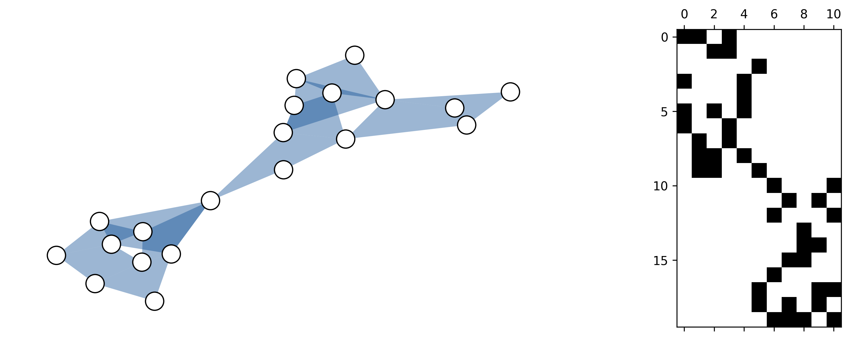
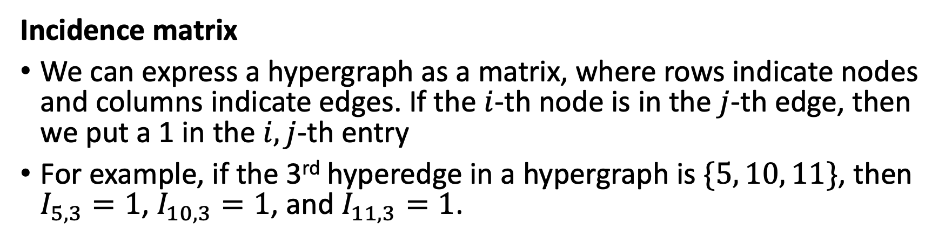
Bipartite cont.
Edges
Nodes
Incidence matrix
We can express a hypergraph as a matrix, where rows indicate nodes and columns indicate edges. If the $i$-th node is in the $j$-th edge, then we put a 1 in the $i,j$-th entry
For example, if the 3rd hyperedge in a hypergraph is $\{5, 10, 11\}$, then $I_{5, 3}=1$, $I_{10, 3}=1$, and $I_{11, 3}=1$.

Slide 25
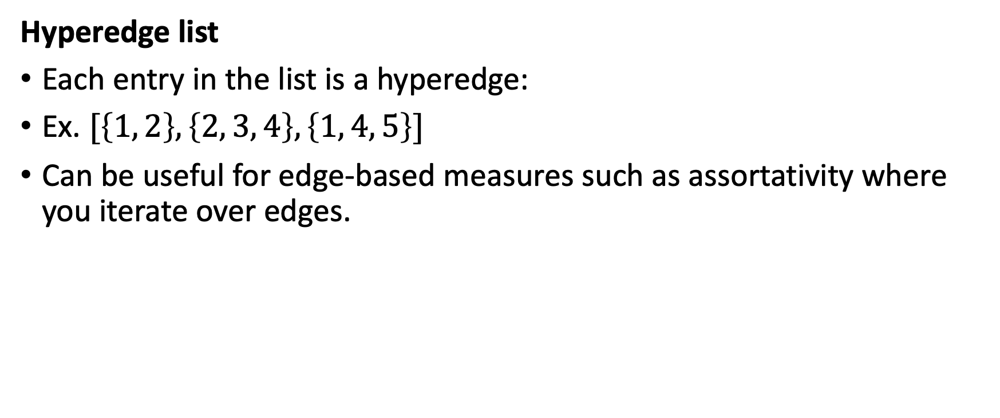
Other
Hyperedge list
Each entry in the list is a hyperedge:
Ex. $[\left\{1, 2\right\}, \left\{2, 3, 4\right\}, \left\{1, 4, 5\right\}]$
Can be useful for edge-based measures such as assortativity where you iterate over edges.

Slide 26
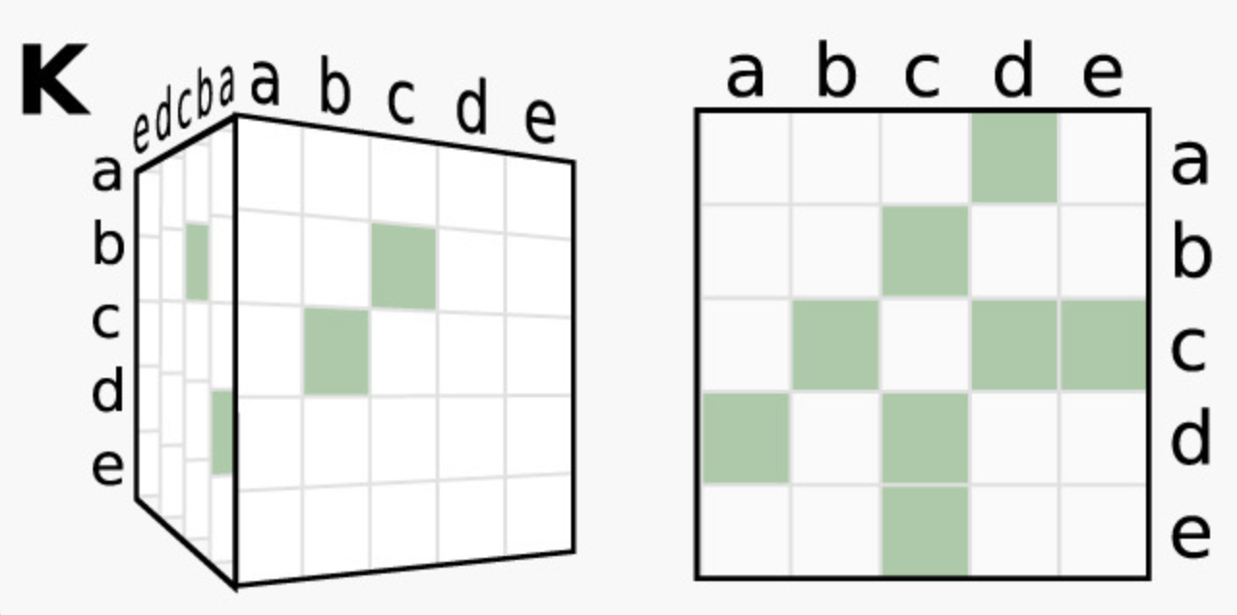
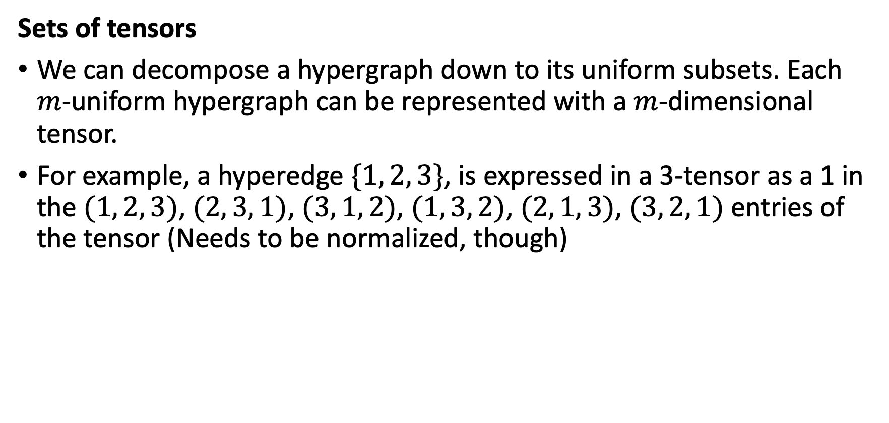
Other cont.
Sets of tensors
We can decompose a hypergraph down to its uniform subsets. Each $m$-uniform hypergraph can be represented with a $m$-dimensional tensor.
For example, a hyperedge $\{1, 2, 3\}$, is expressed in a 3-tensor as a 1 in the $(1, 2, 3)$, $(2, 3, 1)$, $(3, 1, 2)$, $(1, 3, 2)$, $(2, 1, 3)$, $(3, 2, 1)$ entries of the tensor (Needs to be normalized, though)

Slide 27
Lossy representations
Adjacency matrix
There is a pairwise link between nodes if the nodes are connected by at least one hyperedge
More than one hypergraph can make the same adjacency matrix
Line graph
The adjacency matrix but for edges, i.e., there is a pairwise link between two edges if they share at least one node in common
Other matrices
Other matrices (Laplacian, clique motif matrix, etc.) are often just different variations or combinations of these matrices.

Slide 28
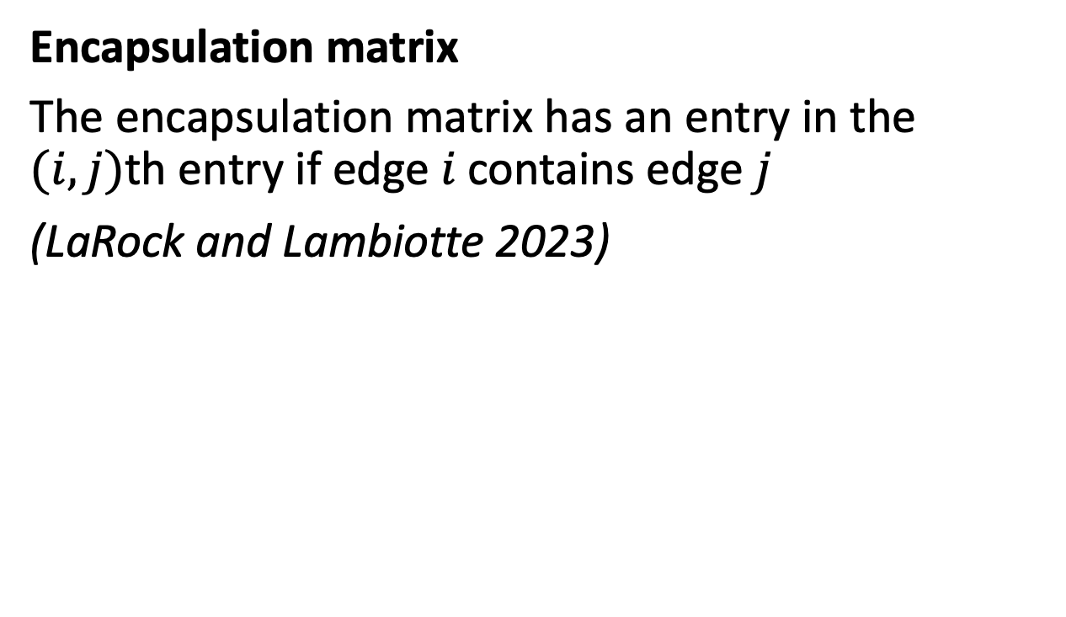
Lossy representations cont.
Encapsulation matrix
The encapsulation matrix has an entry in the $(i,j)$th entry if edge 𝑖 contains edge 𝑗
(LaRock and Lambiotte 2023)

Slide 29
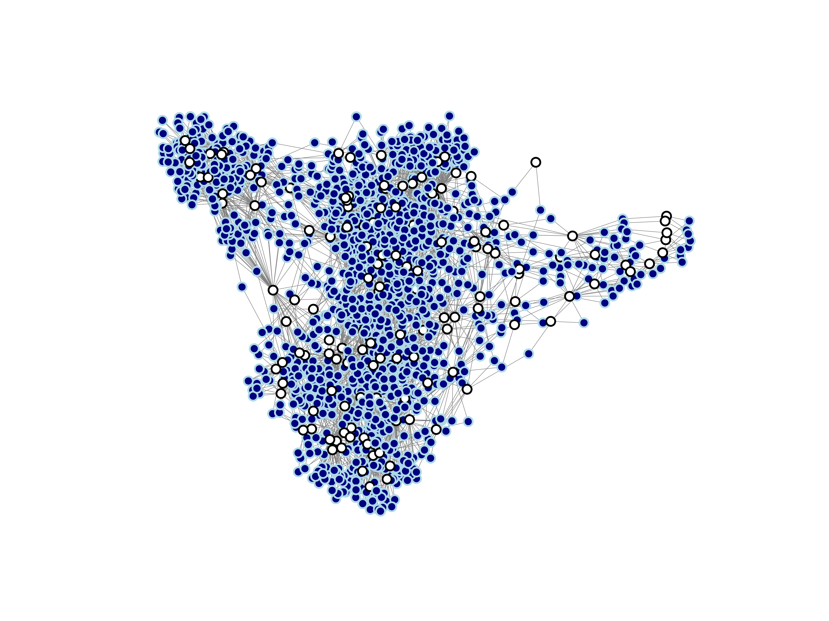
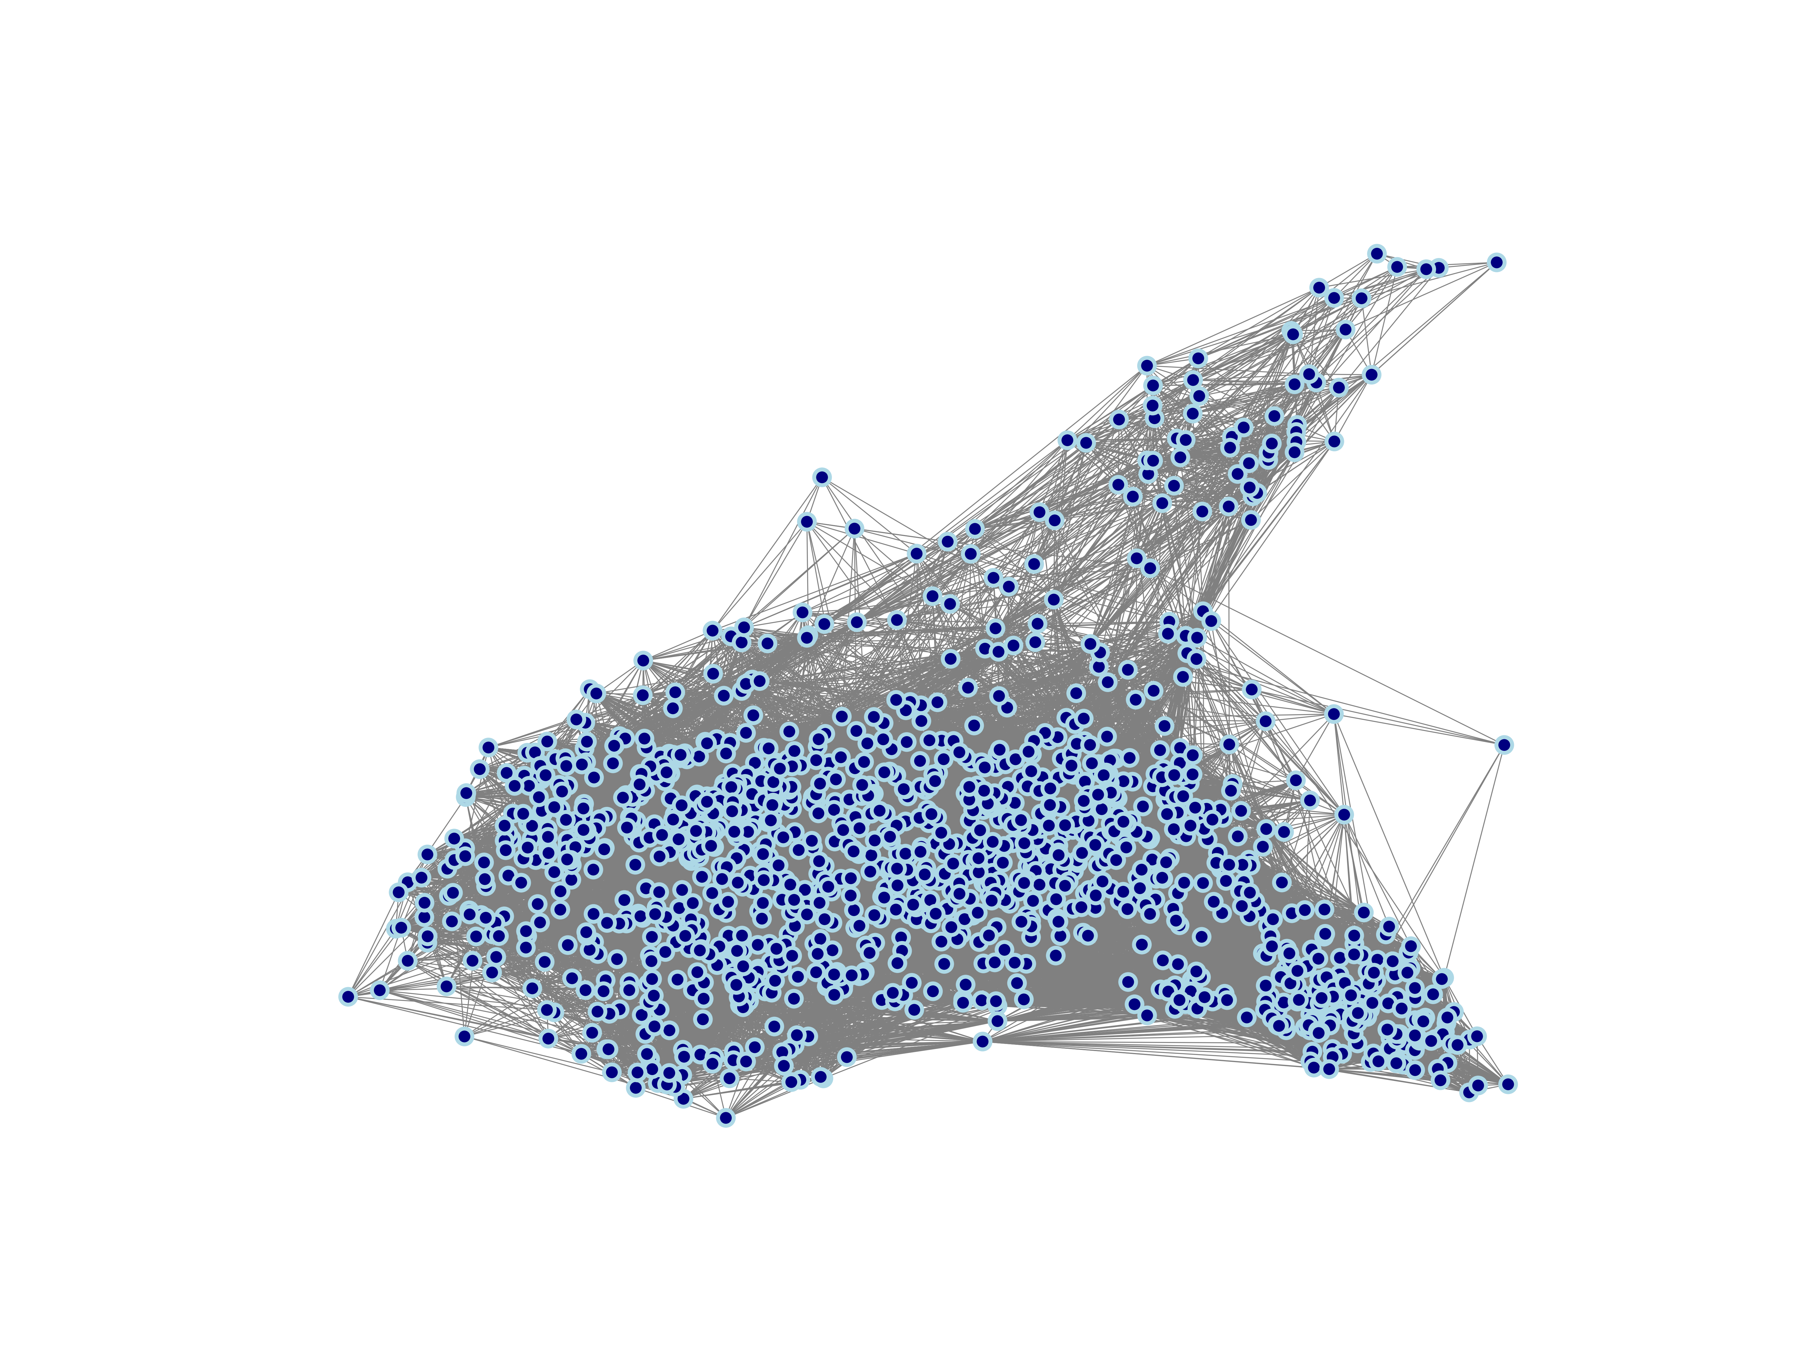
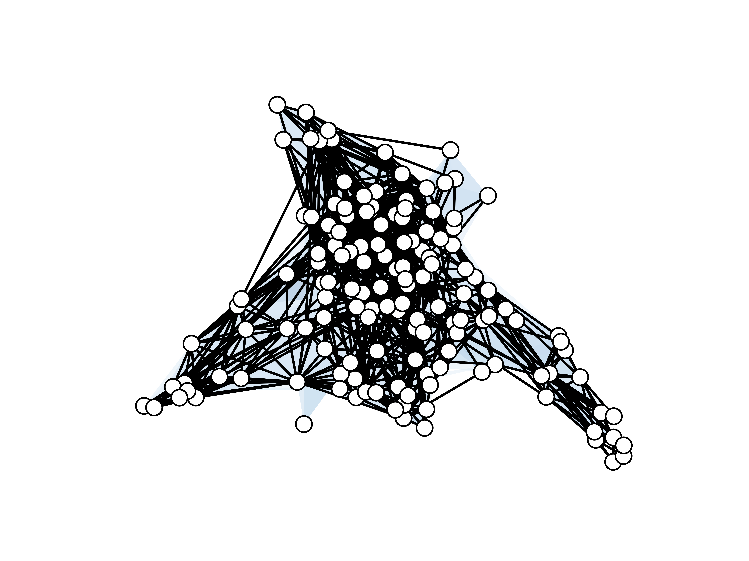
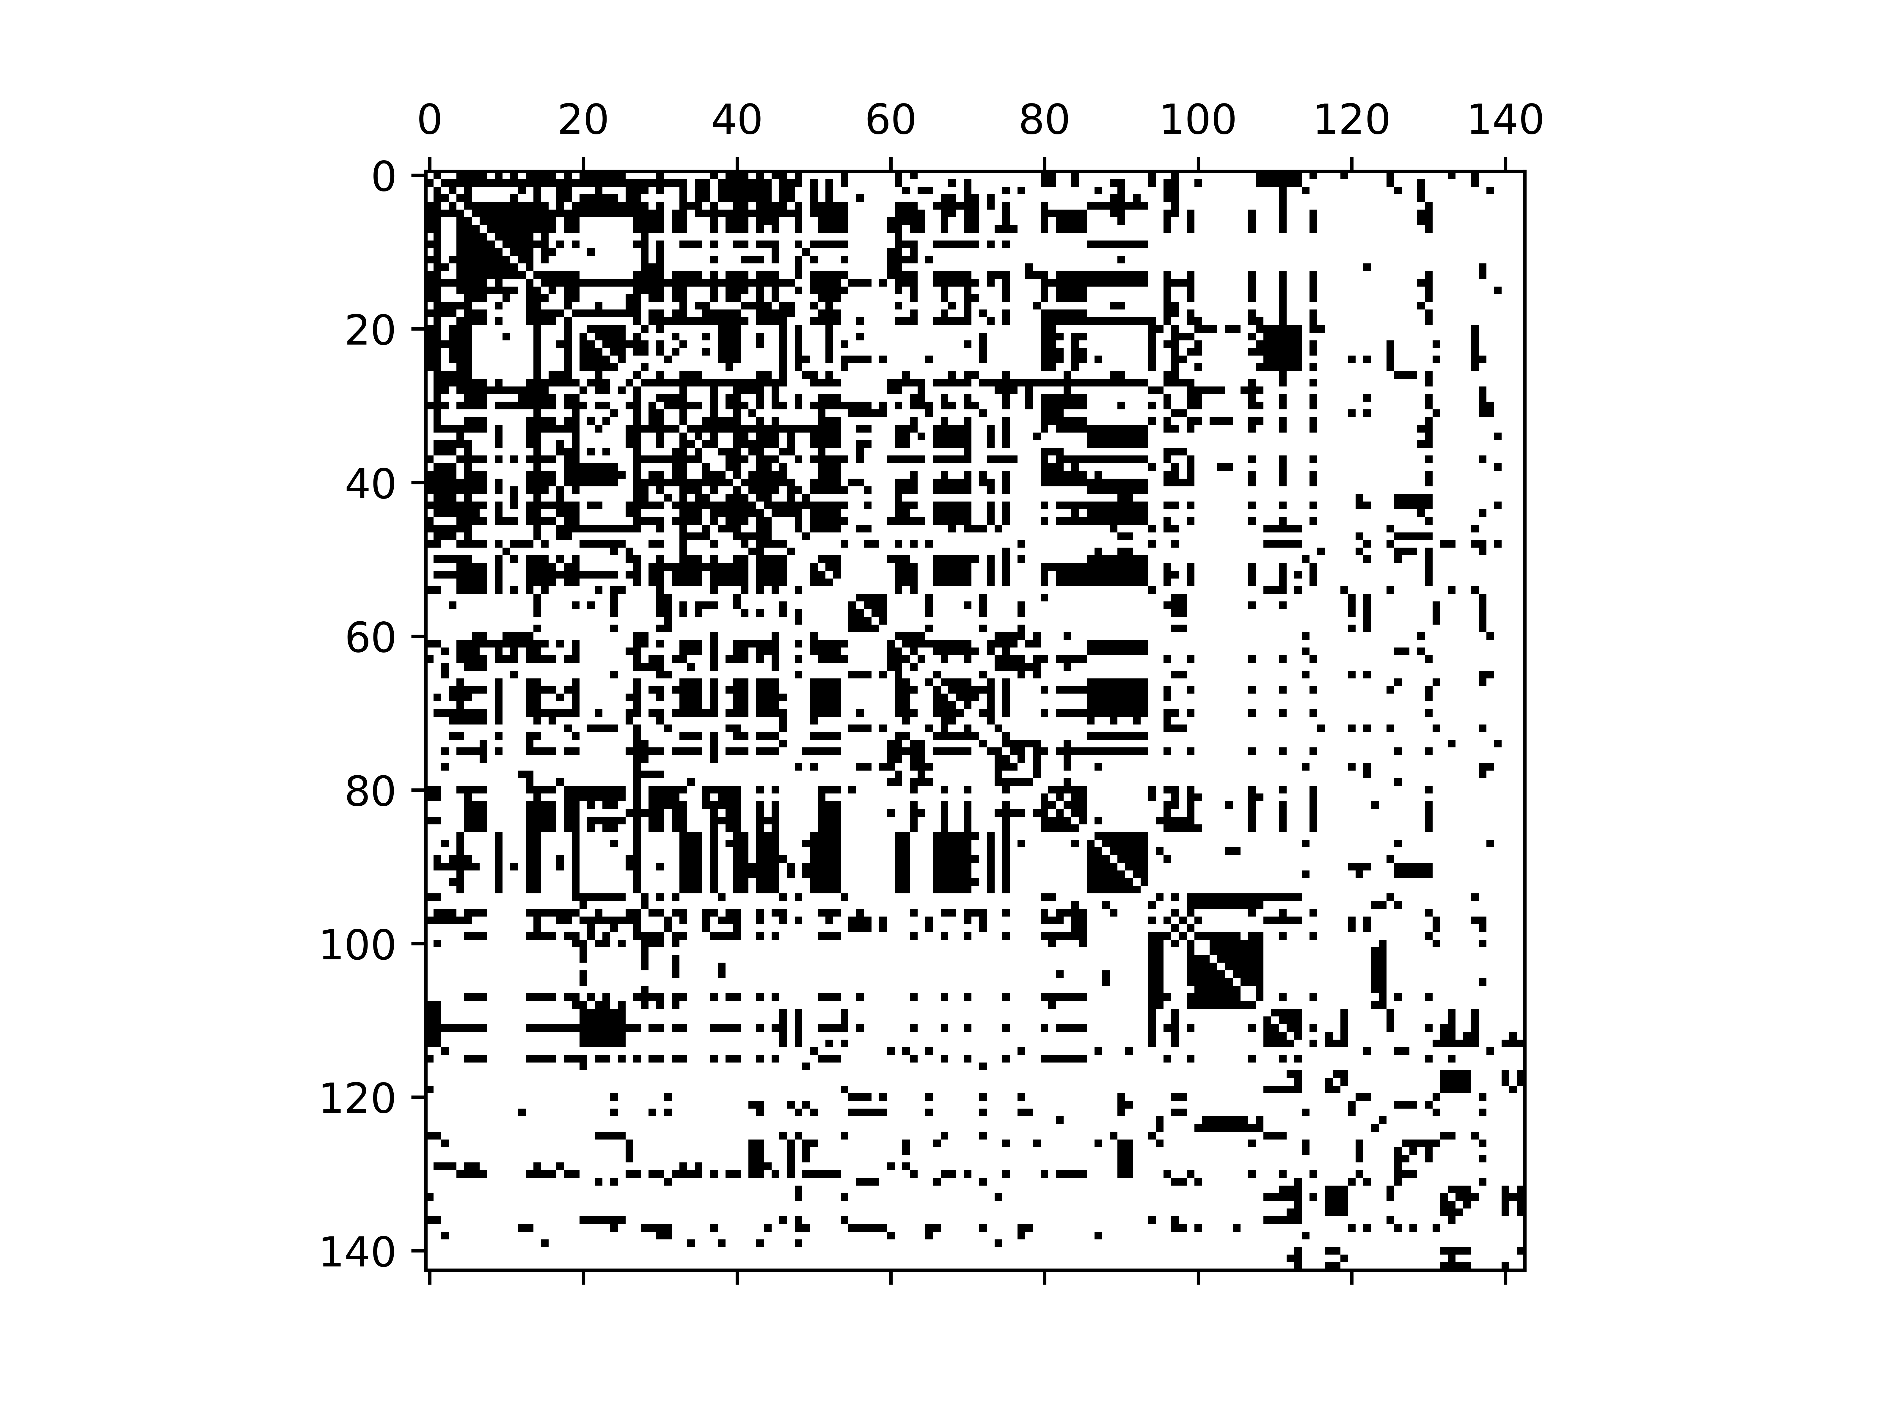
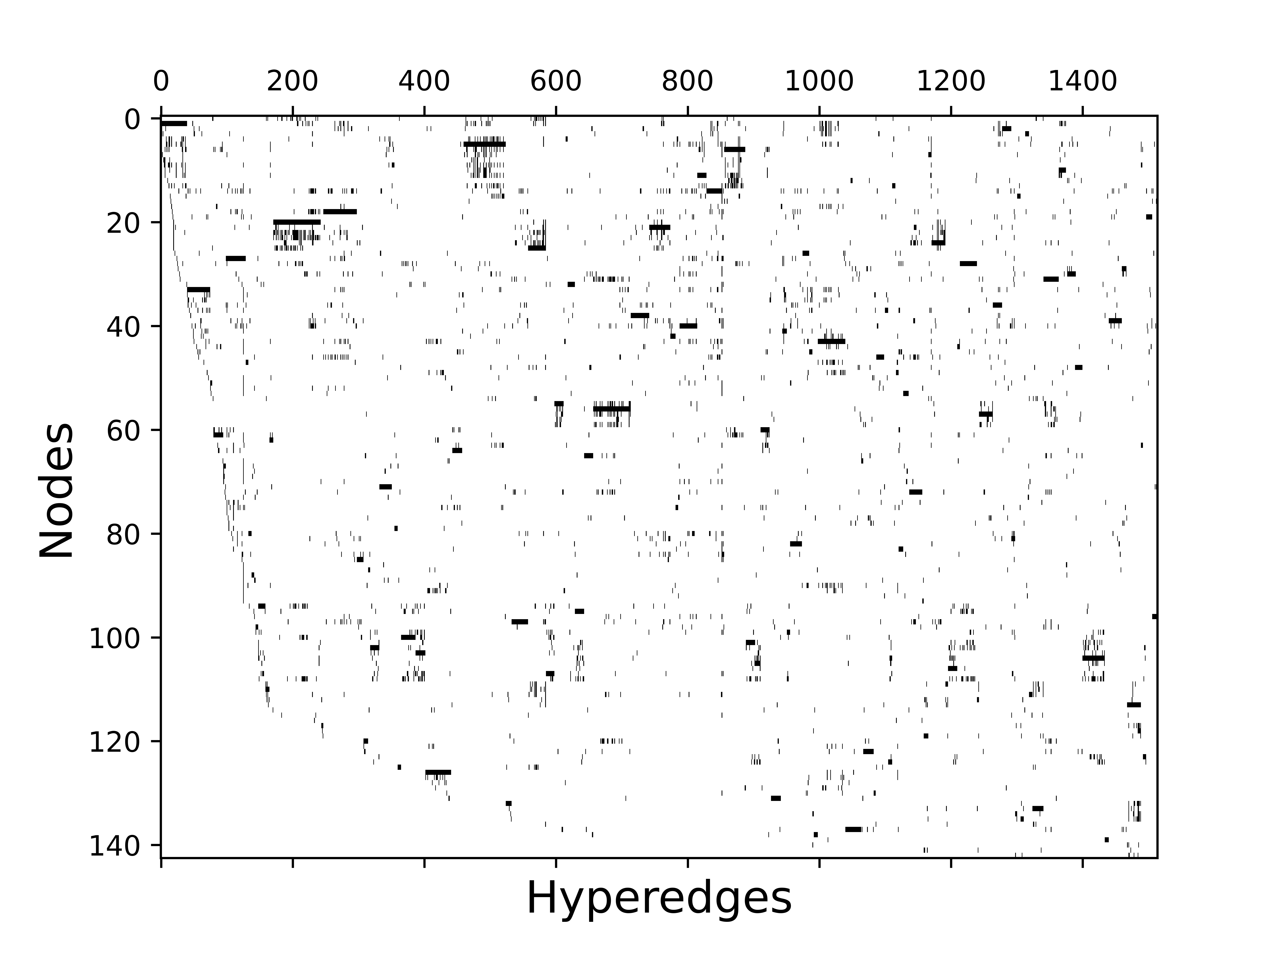
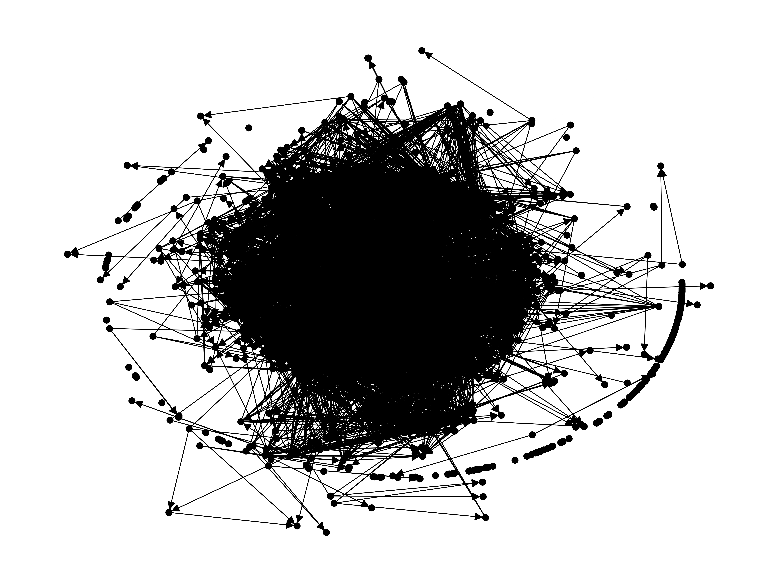
Conversion between representations
Line graph
email-enron
Bipartite network
Adjacency matrix
Incidence matrix
Encapsulation DAG (LaRock 2023)

Slide 30
Considerations: application
Simplicial complexes: maximal faces
Matrices
Pros: quick computations of edge size/degree and linear algebra stuff
Cons: Edge/node relations, depending on matrix representation
Bipartite network
Pros: good for local relations such as neighbors, degree, edge size
Cons: construct the incidence matrix from scratch when you need it
You can use a cache approach (as you need), BUT it will always be space vs. time efficiency. Every time the hypergraph changes, you will need to recompute.
It depends on the application!

Slide 31
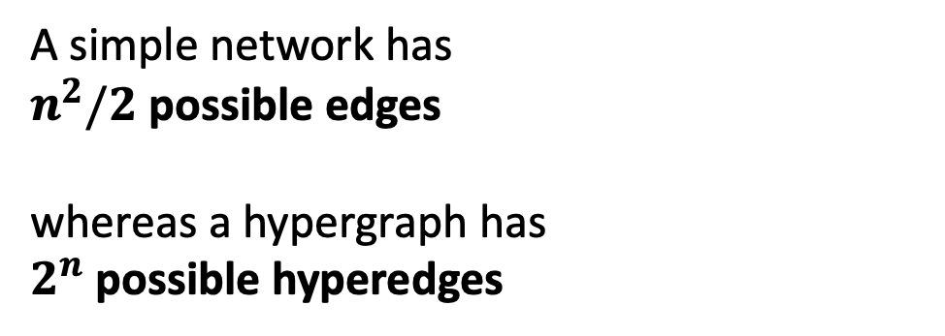
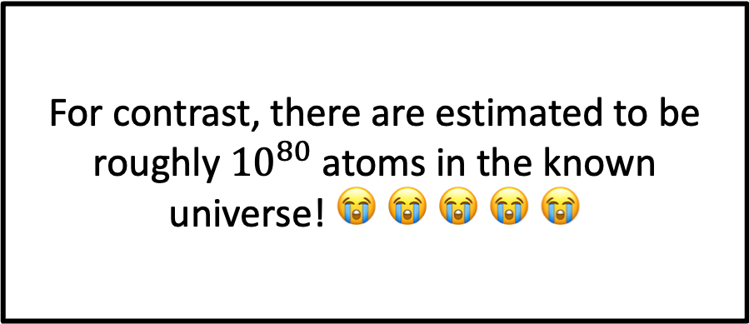
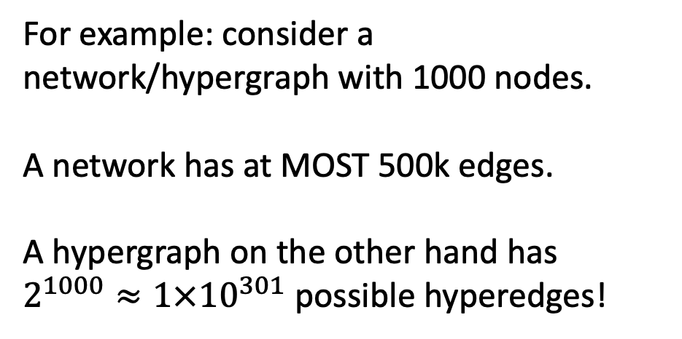
Higher-order networks pose computational difficulties
A simple network has
$n^{2}/2$ possible edges
whereas a hypergraph has
$2^{n}$ possible hyperedges
For contrast, there are estimated to be roughly ${10}^{80}$ atoms in the known universe! 😭 😭 😭 😭 😭
For example: consider a network/hypergraph with 1000 nodes.
A network has at MOST 500k edges.
A hypergraph on the other hand has $2^{1000}≈1×{10}^{301}$ possible hyperedges!

Slide 32
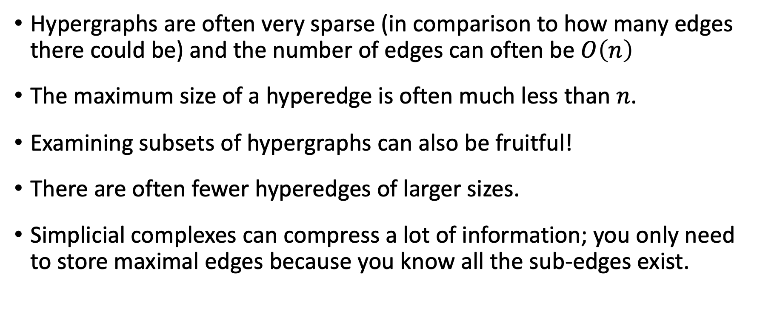
Good news!
Hypergraphs are often very sparse (in comparison to how many edges there could be) and the number of edges can often be $O\left(n\right)$
The maximum size of a hyperedge is often much less than $n$.
Examining subsets of hypergraphs can also be fruitful!
There are often fewer hyperedges of larger sizes.
Simplicial complexes can compress a lot of information; you only need to store maximal edges because you know all the sub-edges exist.

Slide 33
Challenges for the future
Computational feasibility is a big concern
There are cases where pairwise projections do just as well
A lot of metrics are defined on the pairwise projection of the hypergraph
Higher-order interactions can be inferred from pairwise interactions (Sociopatterns)
A lot of work has already been done for bipartite networks
Are dynamics and structure qualitatively different from pairwise networks?

Slide 34
In higher-order networks…
Interactions have size, can overlap, and can include one another.

Slide 35
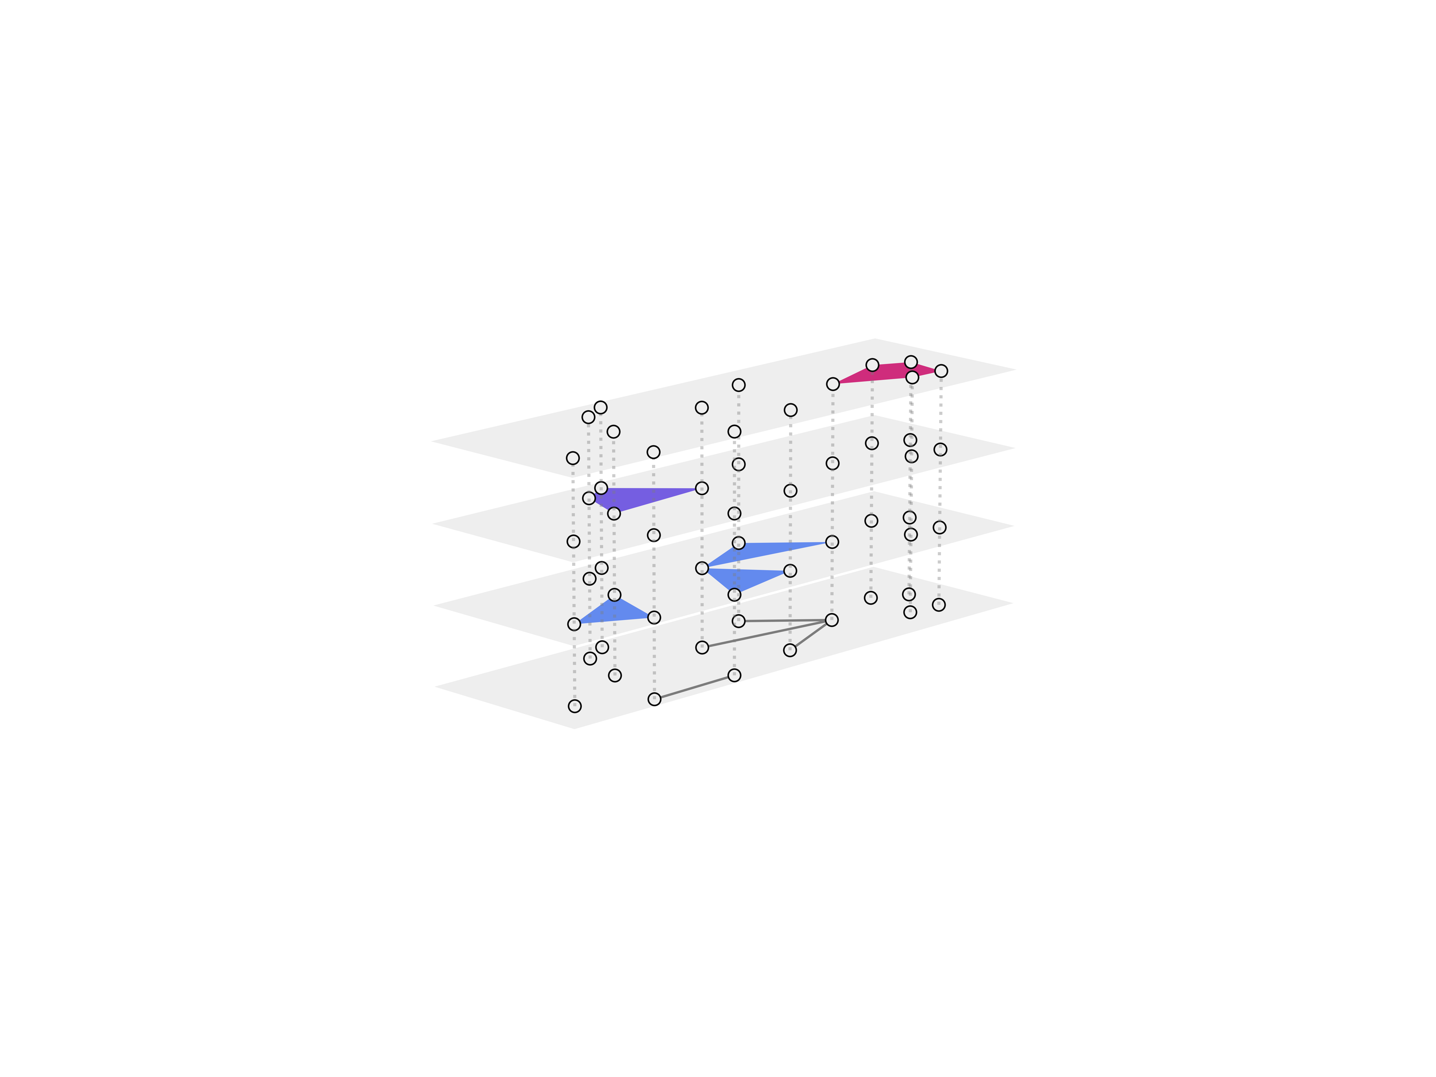
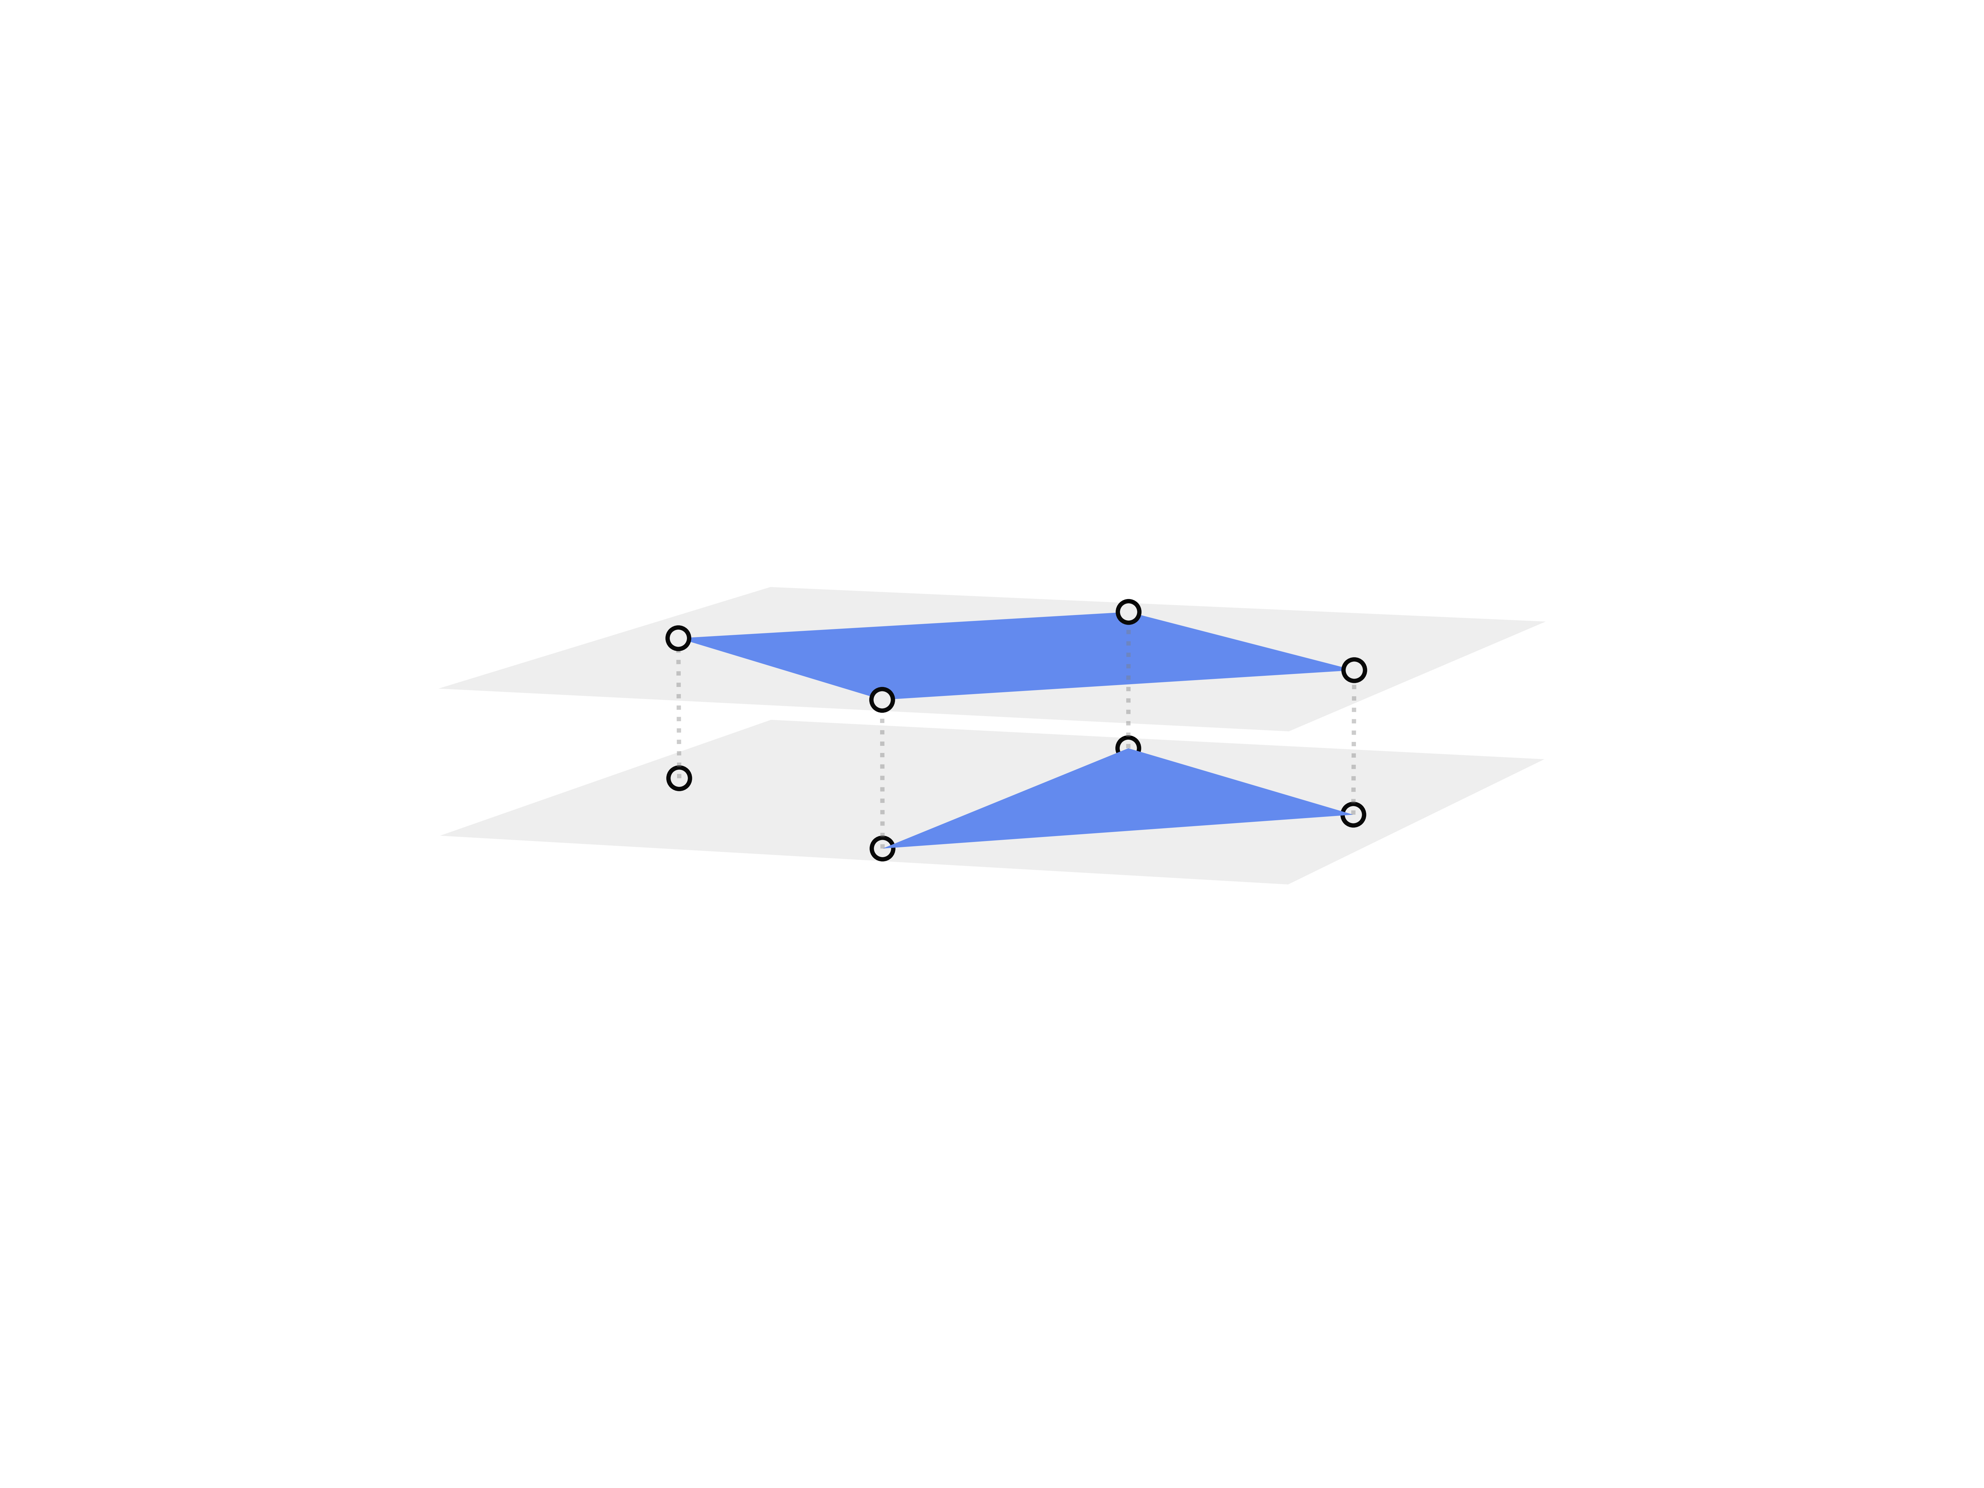
Consequently…
Because hyperedges have size:
Higher-order datasets naturally encode different scales of interaction and network structure may be scale-dependent
Because hyperedges can overlap:
The strength of connection may vary
Because hyperedges can include one another:
A hypergraph can be more or less like a simplicial complex
N. W. Landry, I. Amburg, M. Shi, and S.G. Aksoy, J. Phys. Complex. (2024)
N. W. Landry, J.G. Young, and N. Eikmeier, EPJ Data Sci. (2024)

Slide 36
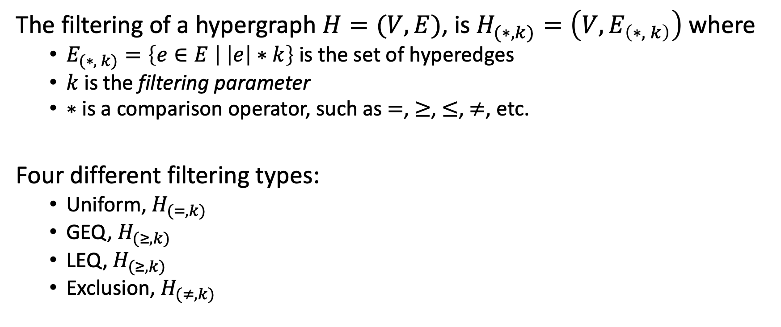
Because edges have size…
The filtering of a hypergraph $H=(V,E)$, is $H_{(∗,k)}=\left(V,E_{\left(∗, k\right)}\right)$ where
$E_{(∗, k)}=\left\{e∈E | \left|e\right|∗k\right\}$ is the set of hyperedges
$k$ is the filtering parameter
$∗$ is a comparison operator, such as $=$, $≥$, $≤$, $≠$, etc.
Four different filtering types:
Uniform, $H_{(=, k)}$
GEQ, $H_{(≥, k)}$
LEQ, $H_{(≥, k)}$
Exclusion, $H_{(≠, k)}$
N. W. Landry, I. Amburg, M. Shi, and S.G. Aksoy, J. Phys. Complex. (2024)

Slide 37
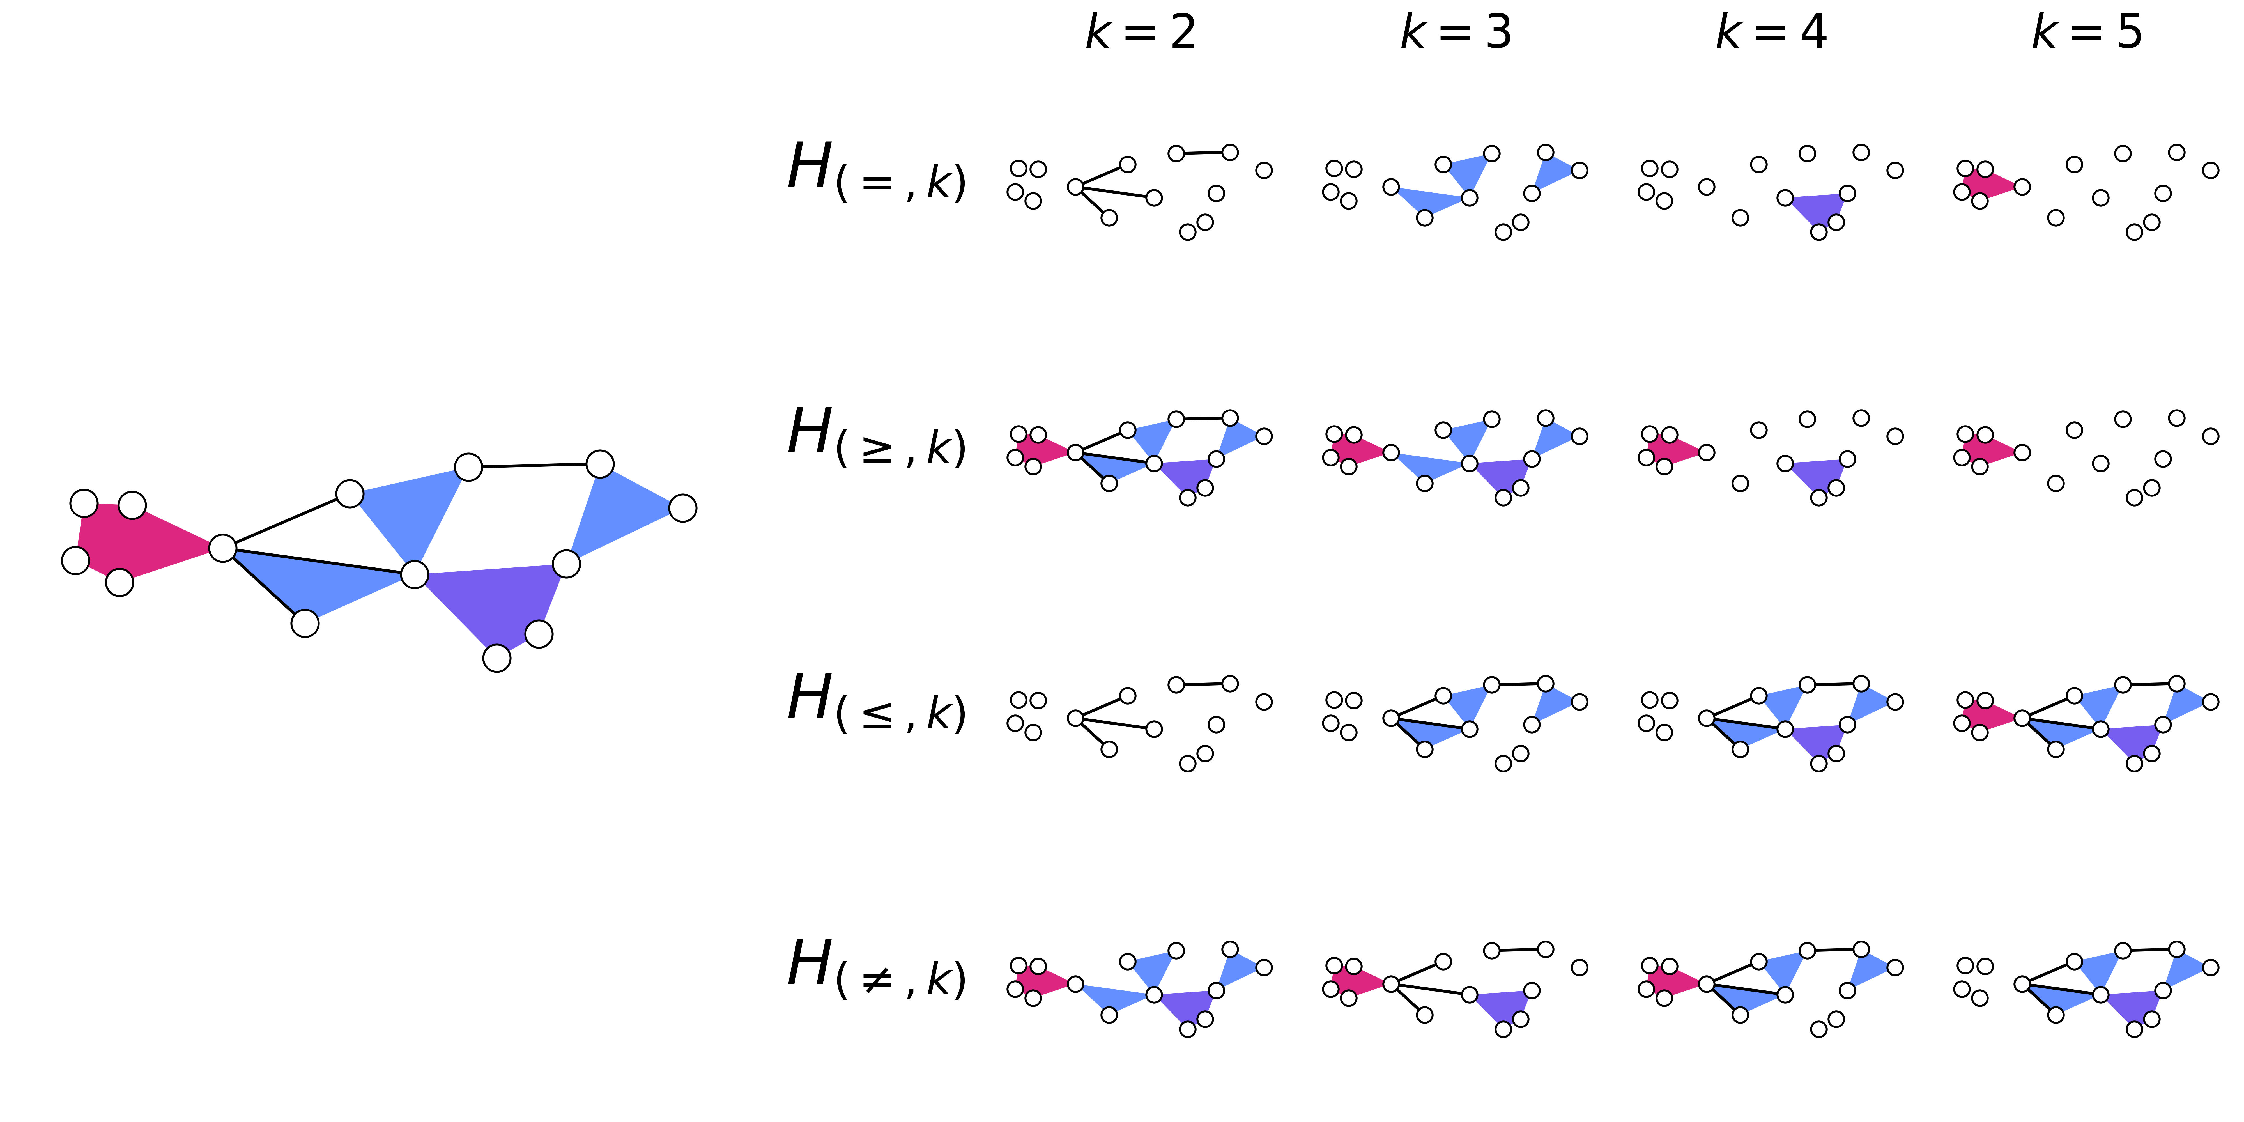
A toy example
N. W. Landry, I. Amburg, M. Shi, and S.G. Aksoy, J. Phys. Complex. (2024)

Slide 38

A case study
email-enron dataset
Emails between a core set of employees at Enron, where nodes indicate email addresses and edges indicate email messages

Slide 39
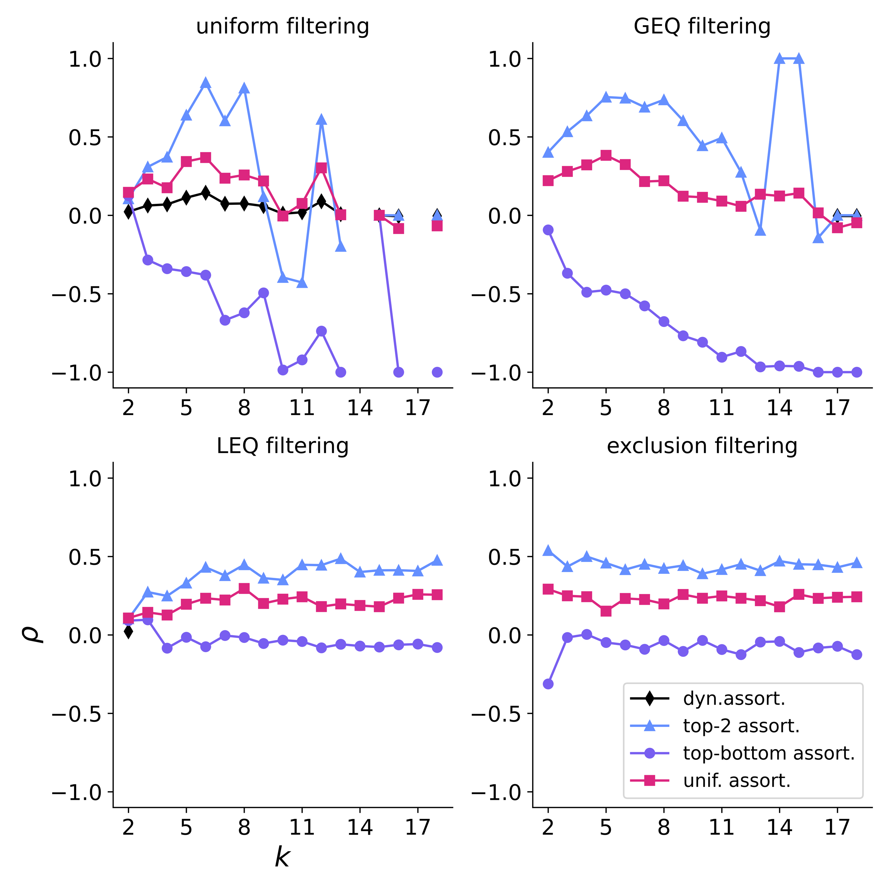
Assortativity
Degree assortativity: The tendency of nodes with similar degree to connect.
Sizes 5-8 are most assortative (uniform, GEQ)
Assortativity is most influenced by pairwise interactions (exclusion)
N. W. Landry, I. Amburg, M. Shi, and S.G. Aksoy, J. Phys. Complex. (2024)

Slide 40
Community structure
Groups of nodes switch memberships as larger interaction sizes are included (LEQ)
Certain nodes not only fail to join groups of a given size or larger, but their community label changes as well (GEQ).
Interactions of a single size can be enough to change the community to which certain nodes belong (exclusion).

Slide 41
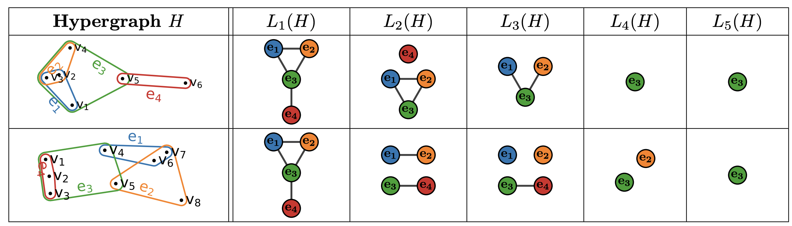
Because edges overlap…
We can quantify the overlapness using s-line graphs.
The s-line graph is composed of nodes representing hyperedges and edges between two nodes if the hyperedges that they represent share at least s nodes.
S. G. Aksoy et al., EPJ Data Science (2020)

Slide 42
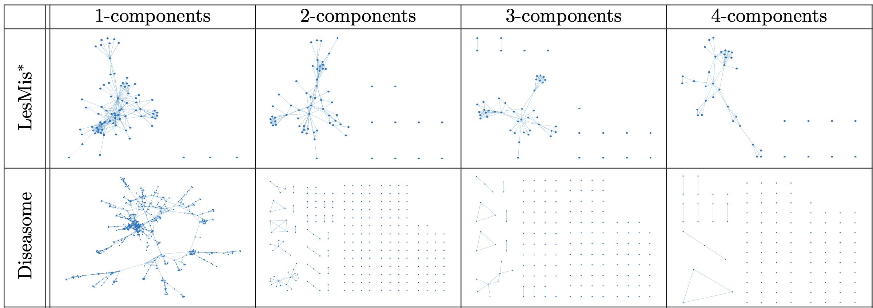
Higher-order networks vary in the strength of their connection
S. G. Aksoy et al., EPJ Data Science (2020)

Slide 43
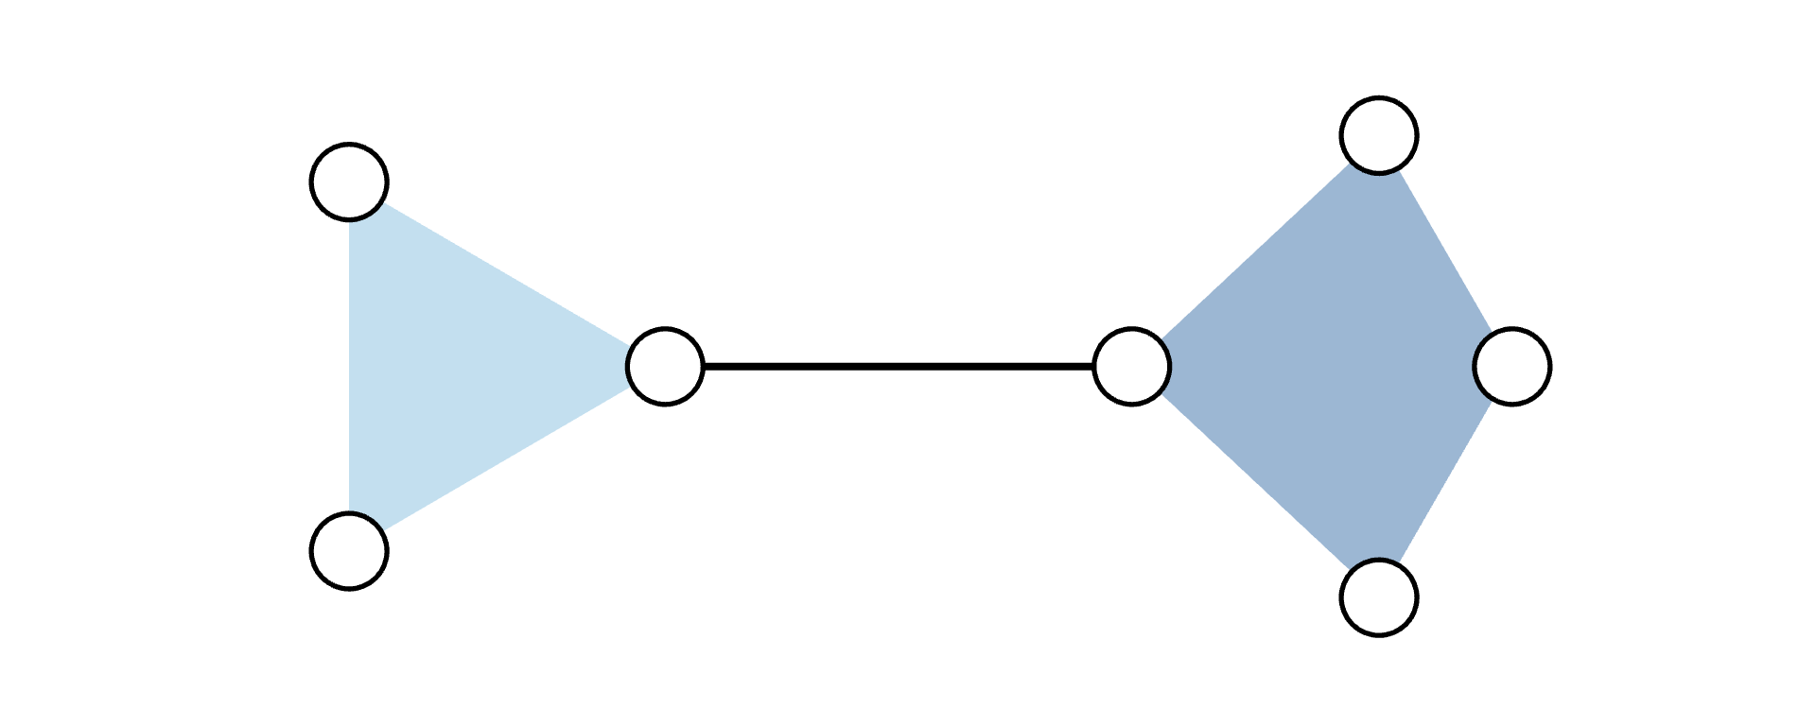


Because edges can include one another…
Definition: We introduce simpliciality ($σ$) as a measure that
satisfies $σ\left(H\right)↦\left[0, 1\right]$
increases as subfaces are added to a hypergraph
is maximal for a simplicial complex
Simpliciality, $σ$
0
1
N. W. Landry, J.G. Young, and N. Eikmeier, EPJ Data Sci. (2024)

Slide 44



Measures of simpliciality
Simplicial fraction ($σ_{SF}$): What fraction of interactions include all of their sub-interactions?
Edit simpliciality ($σ_{ES}$): What fraction of necessary sub-interactions are already present?
Face edit simpliciality ($σ_{FES}$): On average, what fraction of necessary sub-interactions are already present for each maximal interaction?
N. W. Landry, J.G. Young, and N. Eikmeier, EPJ Data Sci. (2024)

Slide 45
Current generative models
When it comes to higher-order generative models, it is all or nothing!
Models that enforce downward closure, e.g., the simplicial configuration model
Models with no consideration for inclusion structure, e.g., the hypergraph Erdös-Rényi model
In reality, simpliciality is a spectrum!
N. W. Landry, J.G. Young, and N. Eikmeier, EPJ Data Sci. (2024)

Slide 46
The datasets
Proximity datasets
Nodes are people and edges are formed by converting a simultaneous clique interaction measured via proximity from wearable badges to a maximal hyperedge.
contact-high-school
contact-primary-school
hospital-lyon
Email
Nodes are email addresses and edges are email messages
email-enron
email-eu
Biologically associated
Nodes and edges measure the co-occurrence of biological substances or properties
diseasome: diseases and symptoms
disgenenet: genes and diseases
ndc-substances: compounds and drugs
Misc.
congress-bills: Nodes represent congresspeople and edges are co-sponsored bills
tags-ask-ubuntu: The edges are posted questions on an online help forum and nodes are topic tags associated with each question.
Recall: a dataset with more included subfaces is more simplicial.

Slide 47

How simplicial are higher-order networks?
Proximity datasets
Email
Biologically associated
Misc.
N. W. Landry, J.G. Young, and N. Eikmeier, EPJ Data Sci. (2024)

Slide 48
How well do generative models capture simpliciality?
We consider three generative models that are easy to fit:
biSBM: Expected degree/edge size sequences + community structure
Hypergraph configuration model: exact degree/edge size sequences
Bipartite Chung-Lu model: Expected degree/edge size sequences
1,000 realizations of each fitted model to each dataset.
N. W. Landry, J.G. Young, and N. Eikmeier, EPJ Data Sci. (2024)

Slide 49

How well do generative models capture simpliciality?
N. W. Landry, J.G. Young, and N. Eikmeier, EPJ Data Sci. (2024)

Slide 50

More realistic higher-order network models and measures
As shown earlier, there are opportunities for models that…
model structure at different scales.
can match the empirical simpliciality of higher-order datasets
There also may be latent structure that can be captured with different higher-order measures.
Assortativity + degree sequence cannot fully capture spreading properties of a hypergraph
N. W. Landry and J. G. Restrepo, Chaos (2022)

Slide 51
References
S. Adhikari, J. G. Restrepo, and P. S. Skardal, “Synchronization of phase oscillators on complex hypergraphs”, Chaos 33, 033116 (2023)
S. G. Aksoy, C. Joslyn, C. Ortiz Marrero, et al. ”Hypernetwork science via high-order hypergraph walks”, EPJ Data Sci. 9, 16 (2020).
I. Iacopini et al. Simplicial models of social contagion. Nat Commun 10, 2485 (2019).
N. W. Landry, J.-G. Young, and N. E. Eikmeier, “The simpliciality of higher-order networks”, EPJ Data Sci. 13, 17 (2024).
N. W. Landry, I. Amburg, M. Shi, and S. G. Aksoy, “Filtering higher-order datasets”, J. Phys. Complex. 5, 1 (2024).
N. W. Landry and J. G. Restrepo, “Hypergraph assortativity: a dynamical systems perspective”, Chaos 32, 053113 (2022)
P. S. Skardal and A. Arenas, “Abrupt Desynchronization and Extensive Multistability in Globally Coupled Oscillator Simplexes”, Phys. Rev. Lett. 122, 248301
T. LaRock and R. Lambiotte J. Phys. Complex. 4 045007 (2023)
L. Neuhäuser, A. Mellor, and R. Lambiotte, “Multibody interactions and nonlinear consensus dynamics on networked systems”, Phys. Rev. E 101, 032310

